Slide 1

CAPSTONE1
University Reviews
Group: C1SE 04 2020

Slide 2

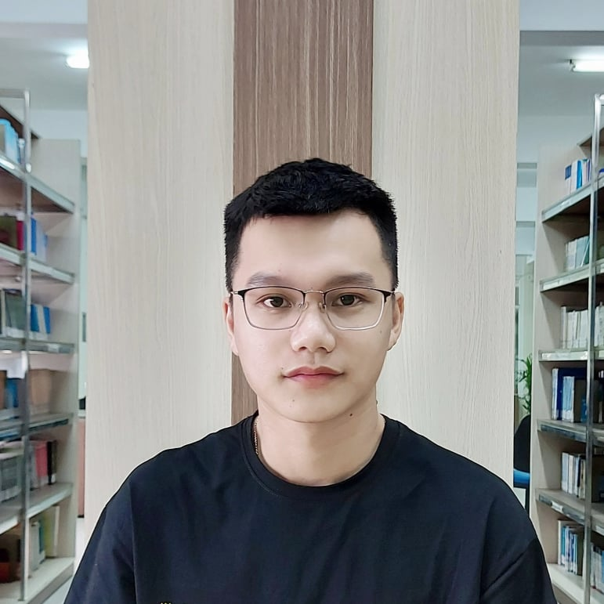
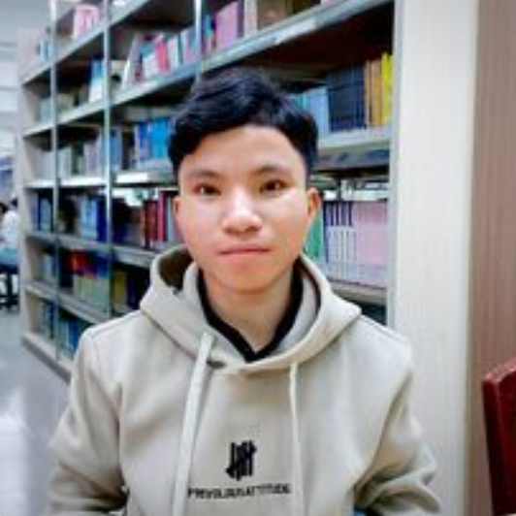

NGUYEN VAN MINH TOI Leader
NGUYEN HUU THIEN Member
HO XUAN SANG Member
HUYNH THI QUY THUONG Member
CAPSTONE1
Members of team
Major: Management Information System

Slide 3

Introduction to mentor
CAPSTONE1
Dr. Ha Thi Nhu Hang
Email : hanhuhangdtu@gmail.com

Slide 4
CONTENTS
BUSSINESS ISSUSE
SOLUTION
ARCHITECTURE PROJECT
PROCESS PROCCESS
DEMO

Slide 5
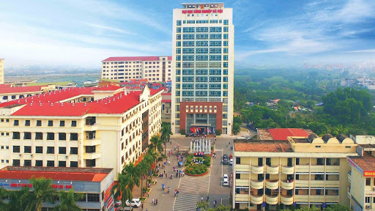
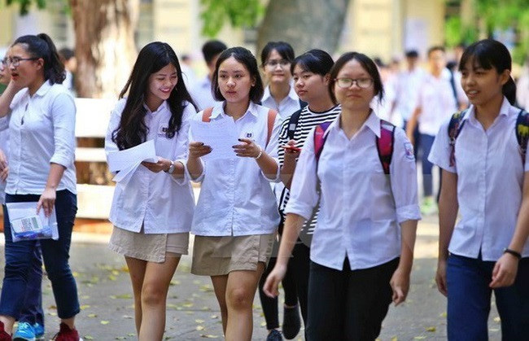
Lots of universities and students
Need a lot of interaction, and There is no suitable website to meet demand
CAPSTONE1
BUSSINESS ISSUES

Slide 6
CAPSTONE1
BUSSINESS NEED

Slide 7
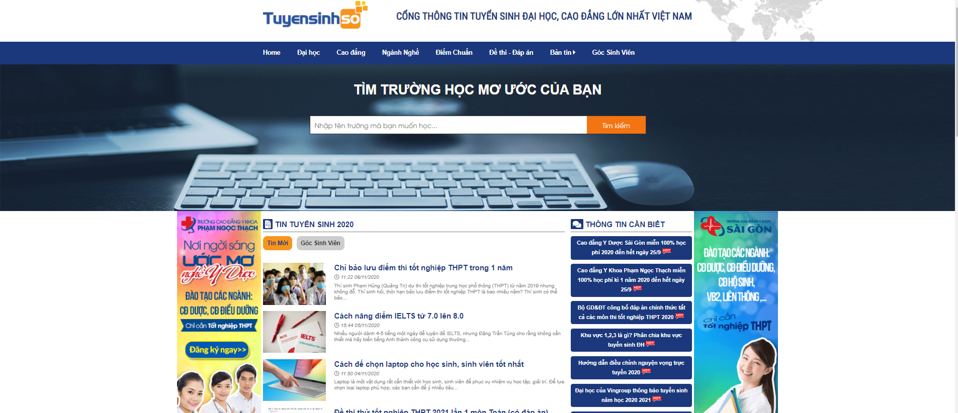
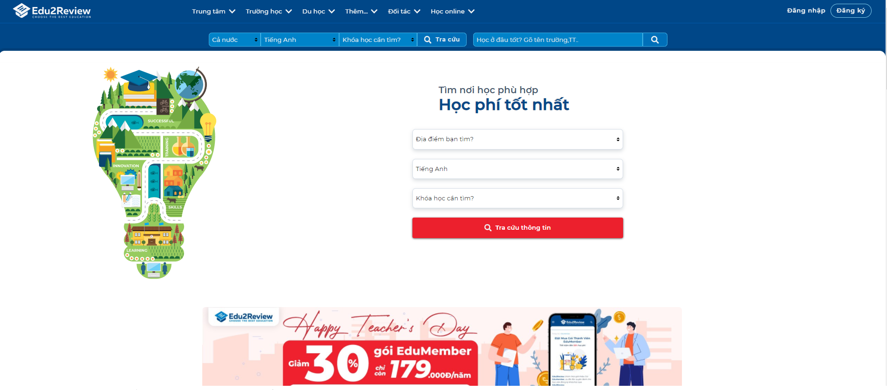
tuyensinhso
edu2review
CAPSTONE1

Slide 8
Who?
Admin
University
User
CAPSTONE1
Manage and control all website content
Fill their information university like their major, their infrastructure …
Watch and interact about the universities they are interested

Slide 9

CAPSTONE1
SOLUTION
Provide all basic information University
There are topics about the school, a place to exchange and answer questions between students who have been studying at the school and candidates.

Slide 10
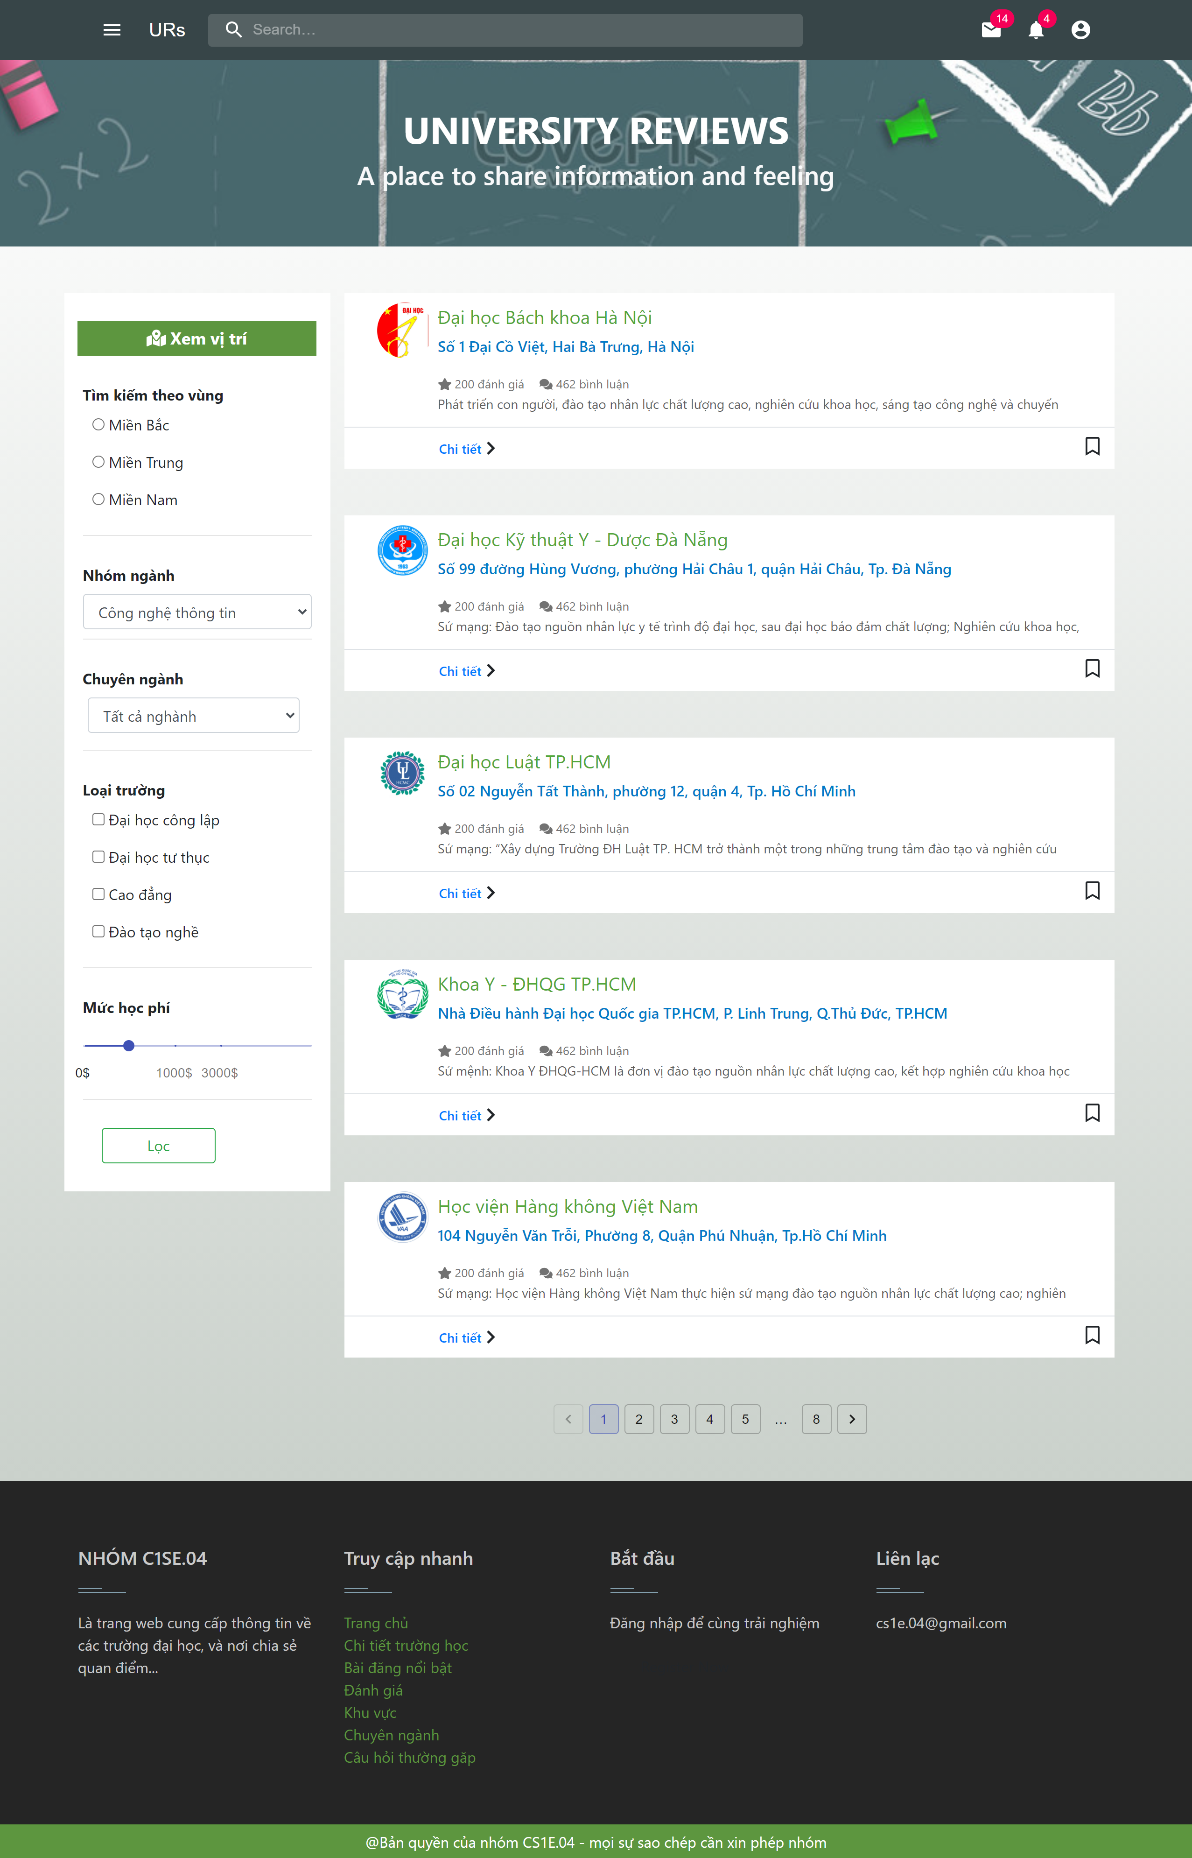
UI for user
CAPSTONE1

Slide 11
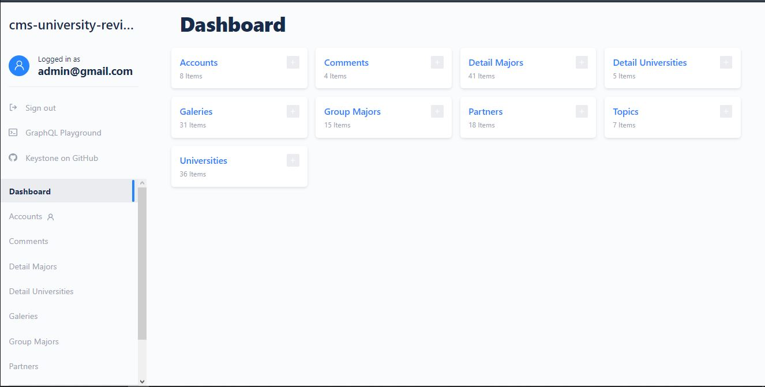
UI for Admin & University
CAPSTONE1

Slide 12
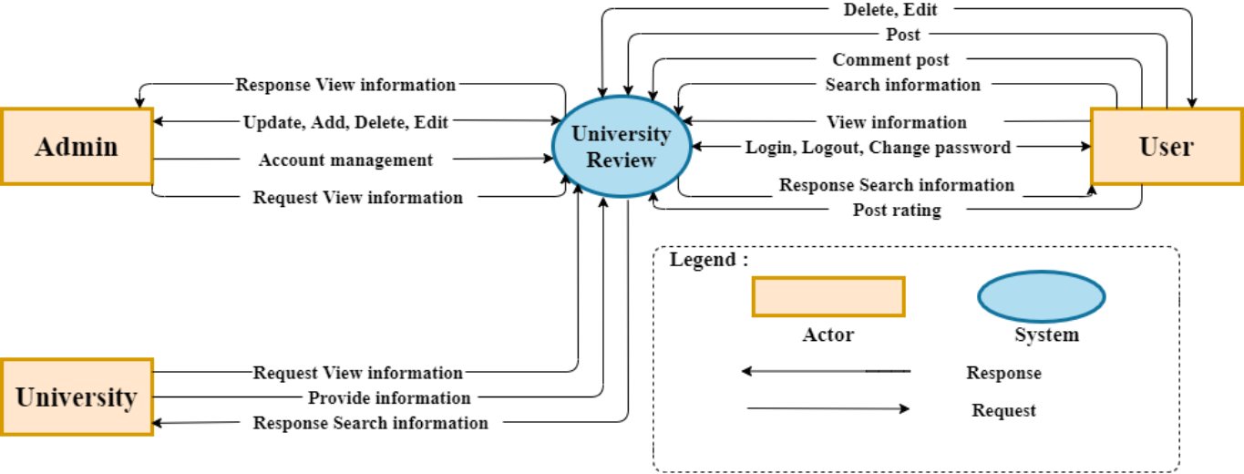
CAPSTONE1
System Context Diagram

Slide 13
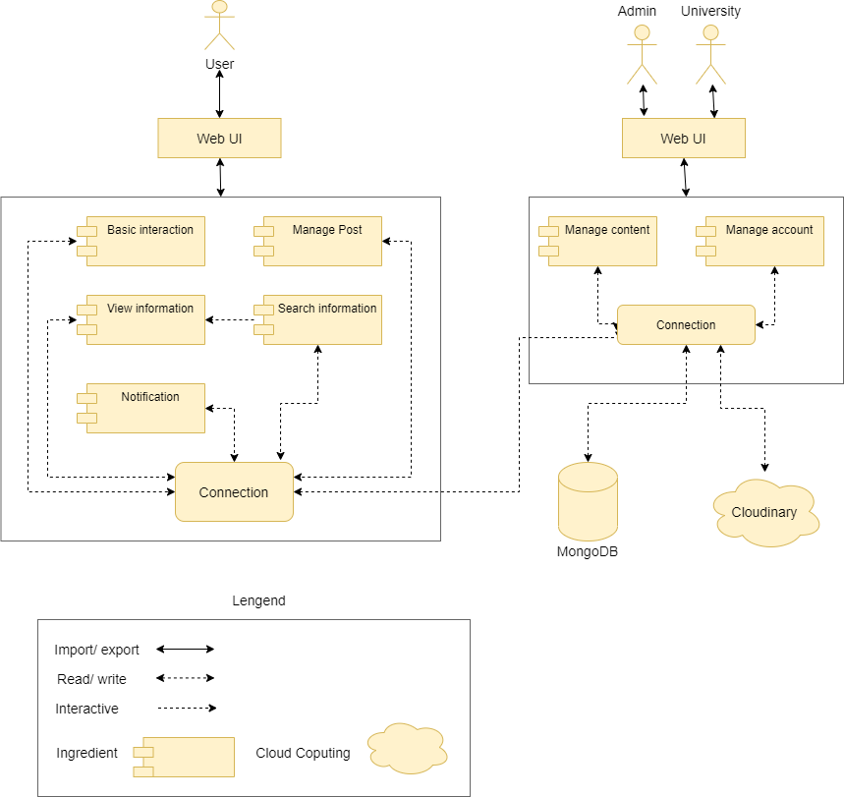
CAPSTONE1
Project Architecture
Component & connection

Slide 14
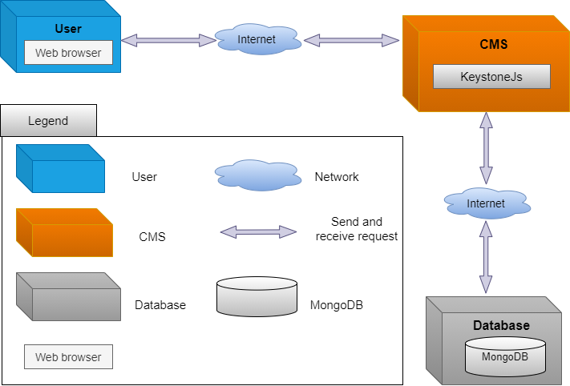
Allocation view
CAPSTONE1
Project Architecture

Slide 15
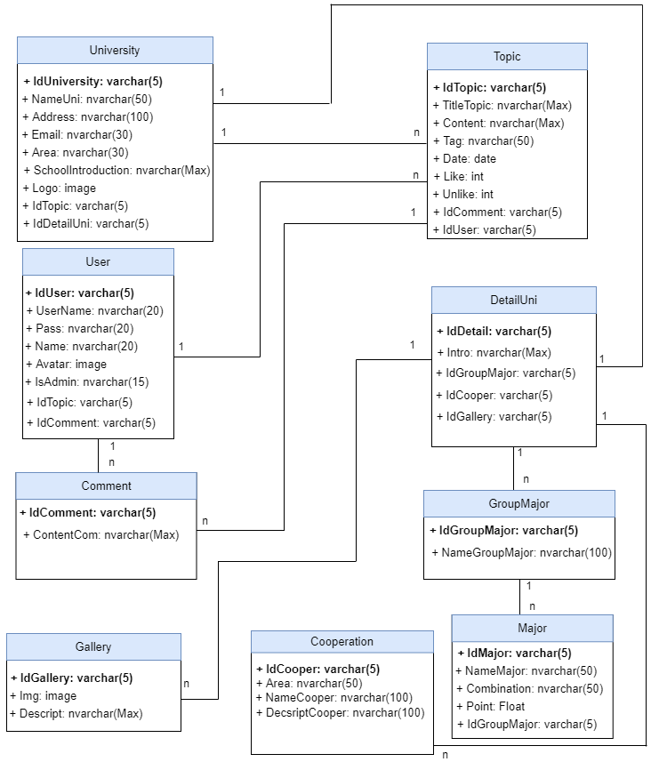
Relationship database
CAPSTONE1

Slide 16






HTML/CSS/JS
NODEJS
REACTJS
KEYSTONEJS
MATERIAL UI
mongodb
Develop tools

Slide 17



Management tools
Trello for management work
Adobe XD for design UI web
CAPSTONE1
Github for management source code

Slide 18
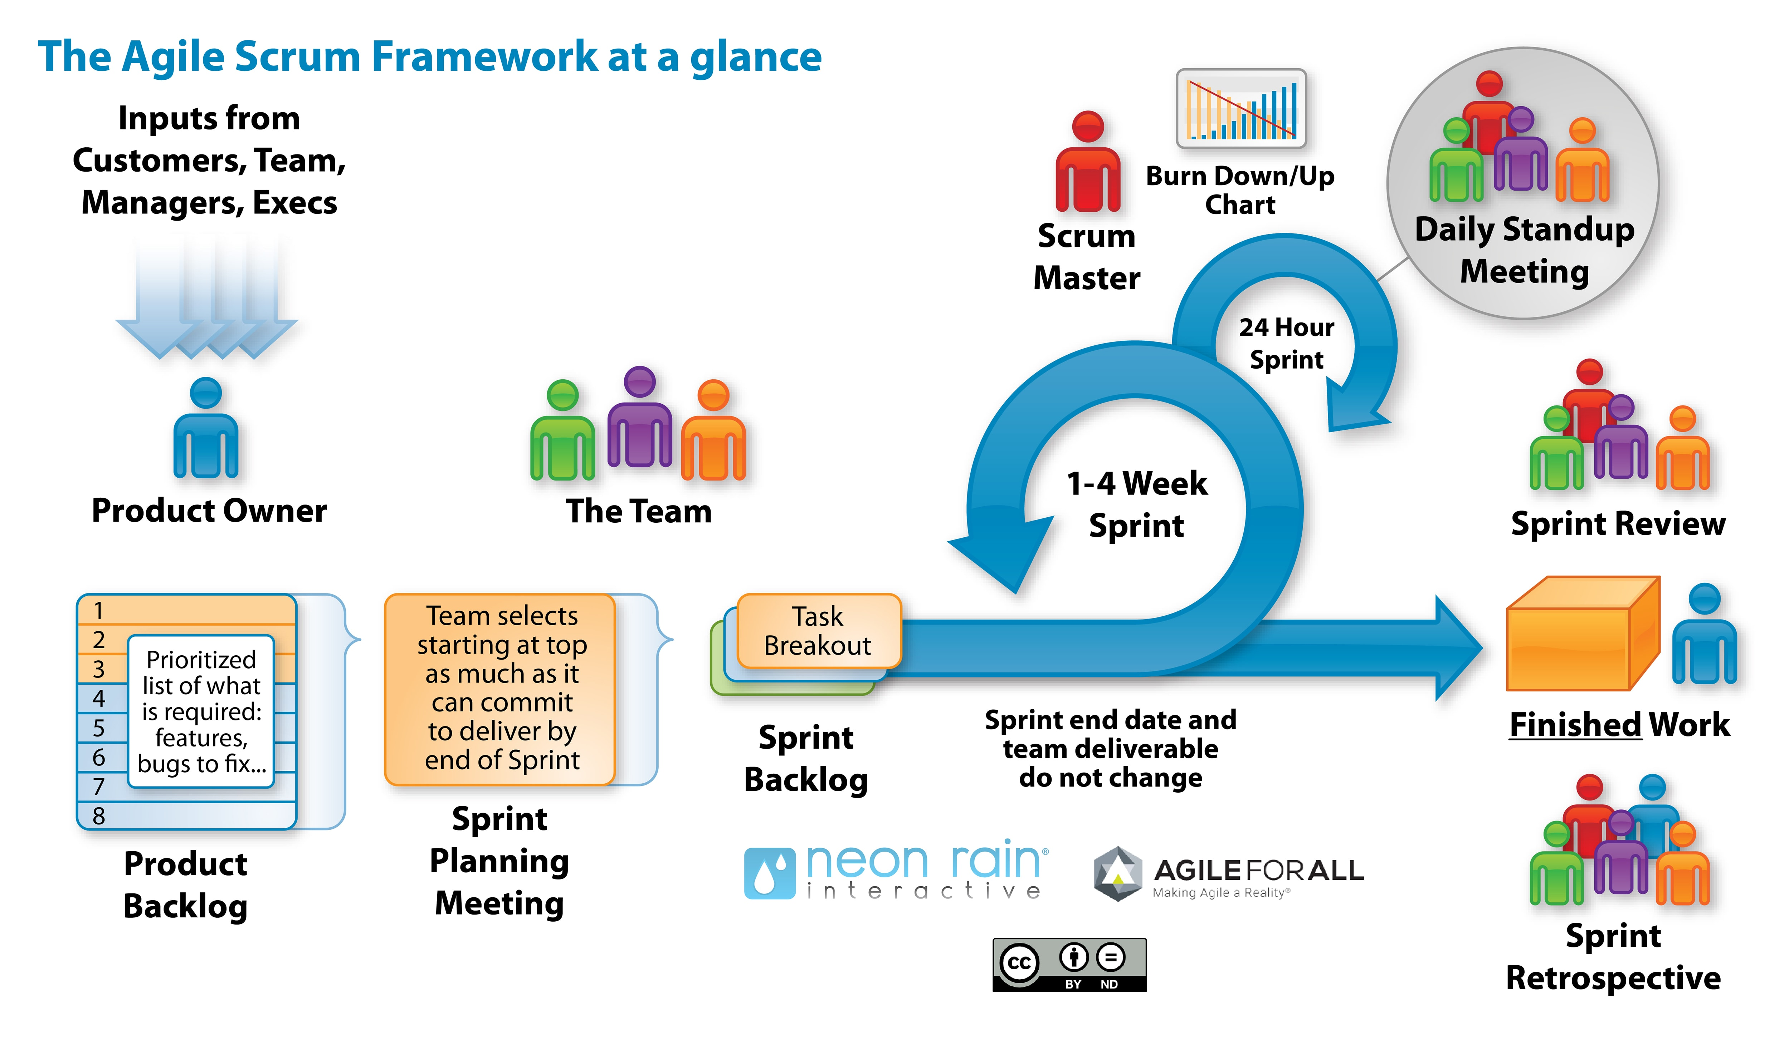
Process Model: Scrum Process
Process model
CAPSTONE1
Scrum is an iterative and incremental agile software development framework for managing software projects and product or application development.

Slide 19
PROJECT PROCESS
CAPSTONE1
ONE
TWO
THREE
Four
SPRINT 1
SPRINT 2
SPRINT 3
SPRINT 4
Start day: 29/08/2020 End day: 25/09/2020
During: 28days
Start day: 25/09/2020 End day: 22/10/2020 During: 28days
Start day: 22/10/2020
End day: 11/11/2020
During: 21days
Start day: 11/11/2020
End day: 01/12/2020
During: 21days

Slide 20
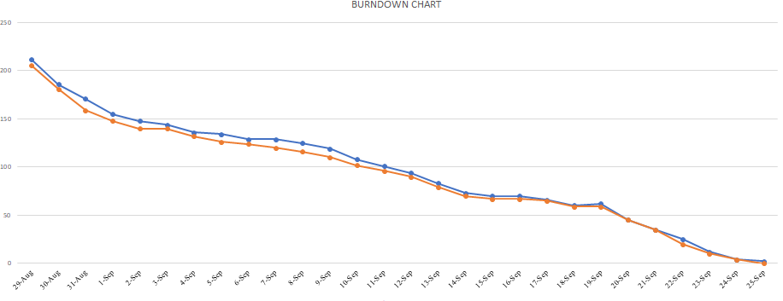
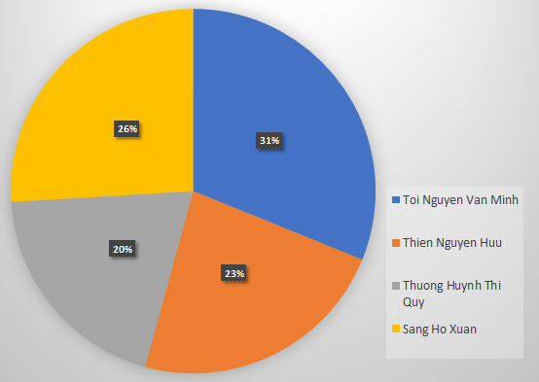
Sprint 1: Burndown Chart
CAPSTONE1

Slide 21
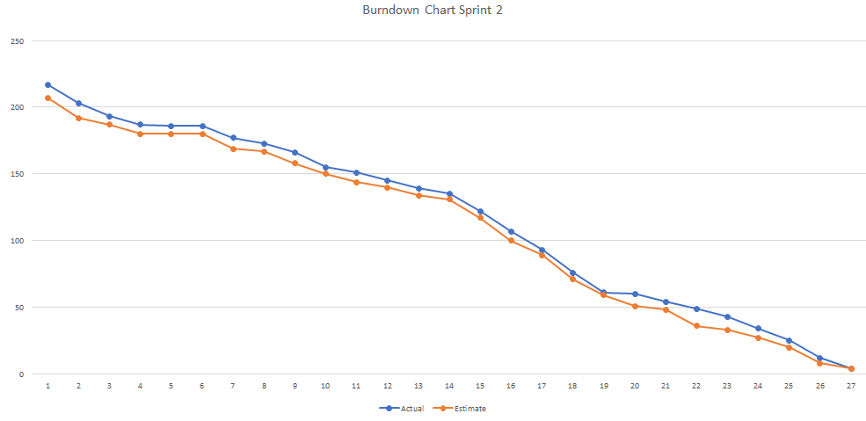
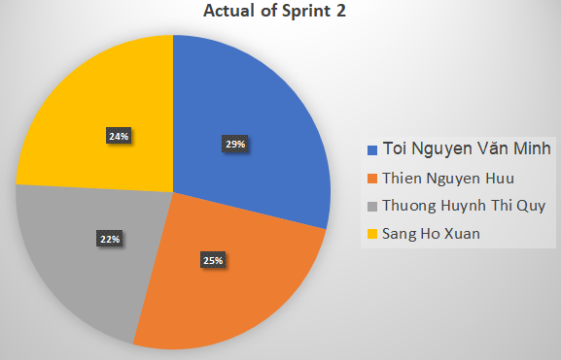
Sprint 2: Burndown Chart
CAPSTONE1

Slide 22
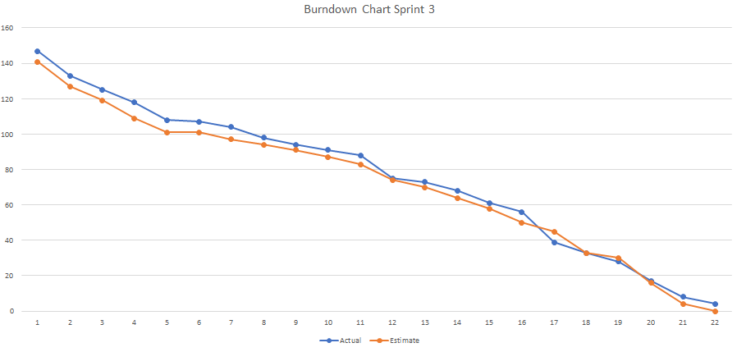
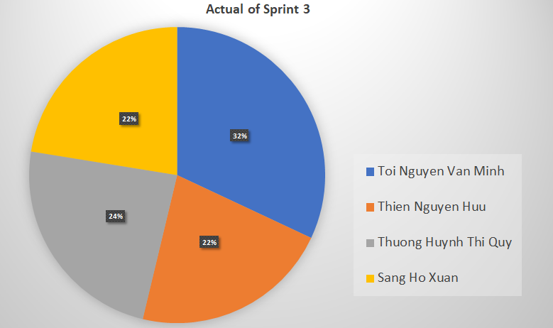
CAPSTONE1
Sprint 3: Burndown Chart

Slide 23
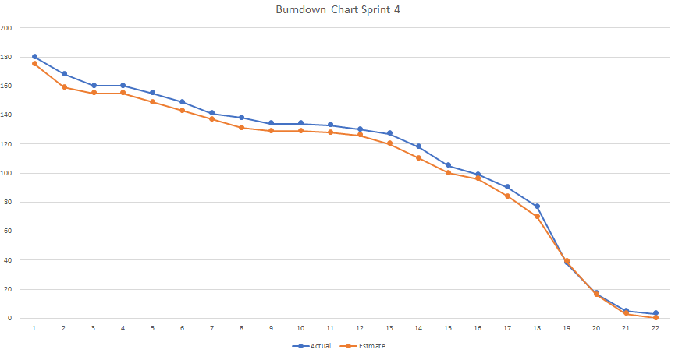
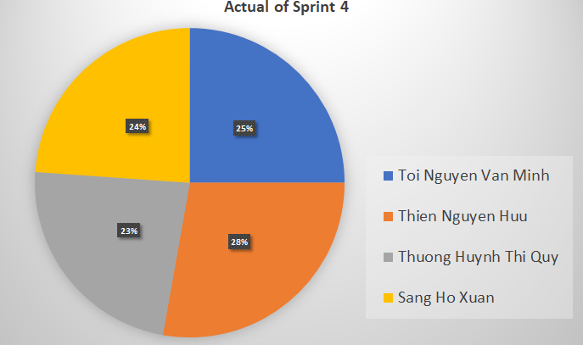
Sprint 4: Burndown Chart
CAPSTONE1

Slide 24



RISKS AND EVALUATION
RISKS
WELL DONE
NOT GOOD
CAPSTONE1
Not much experience of technical.
Schedule is not guaranteed.
Lack of experience in project management.
Team work good.
Responsible members in the project.

Slide 25
CONCLUISION
100% complete
Learning
Difficult
Complete the planned task
New technology
Improve process
Unify ideas and manage time

Slide 26

CAPSTONE1
PRODUCT DEMO

Slide 27
THANKS for listening
Does anyone have any questions?

Slide 28
demo

Slide 29
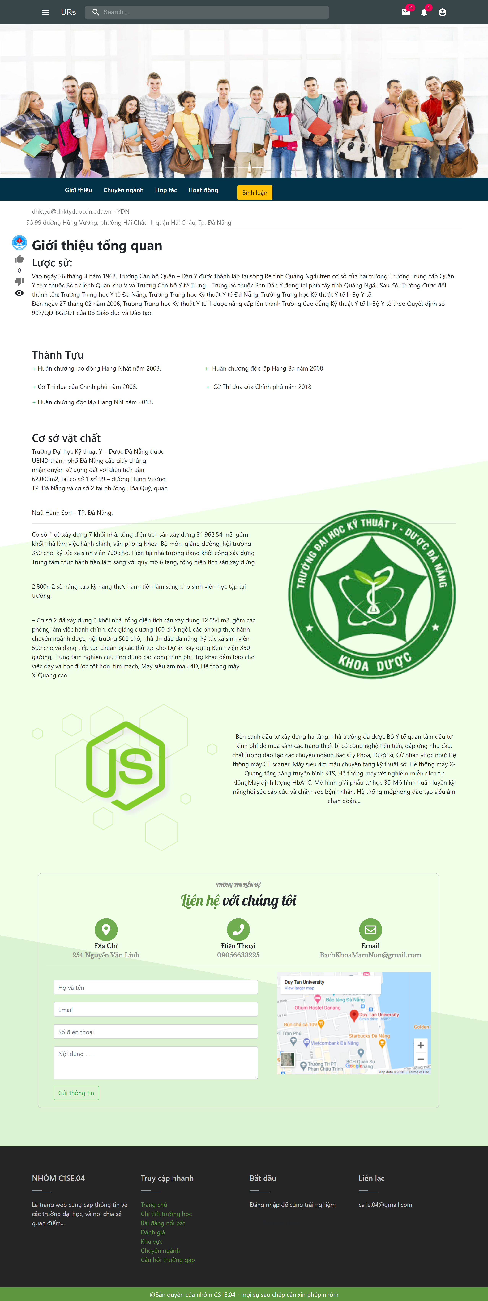
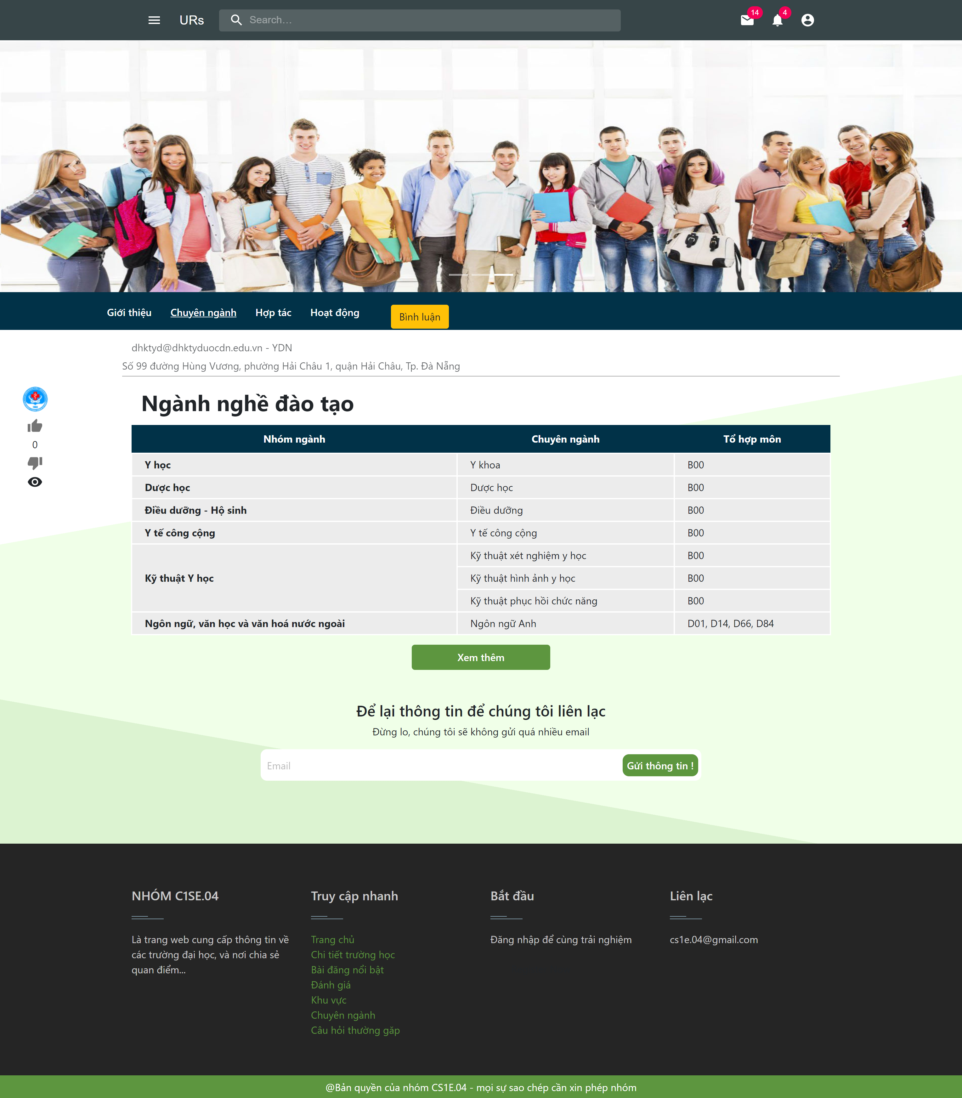
demo

Slide 30
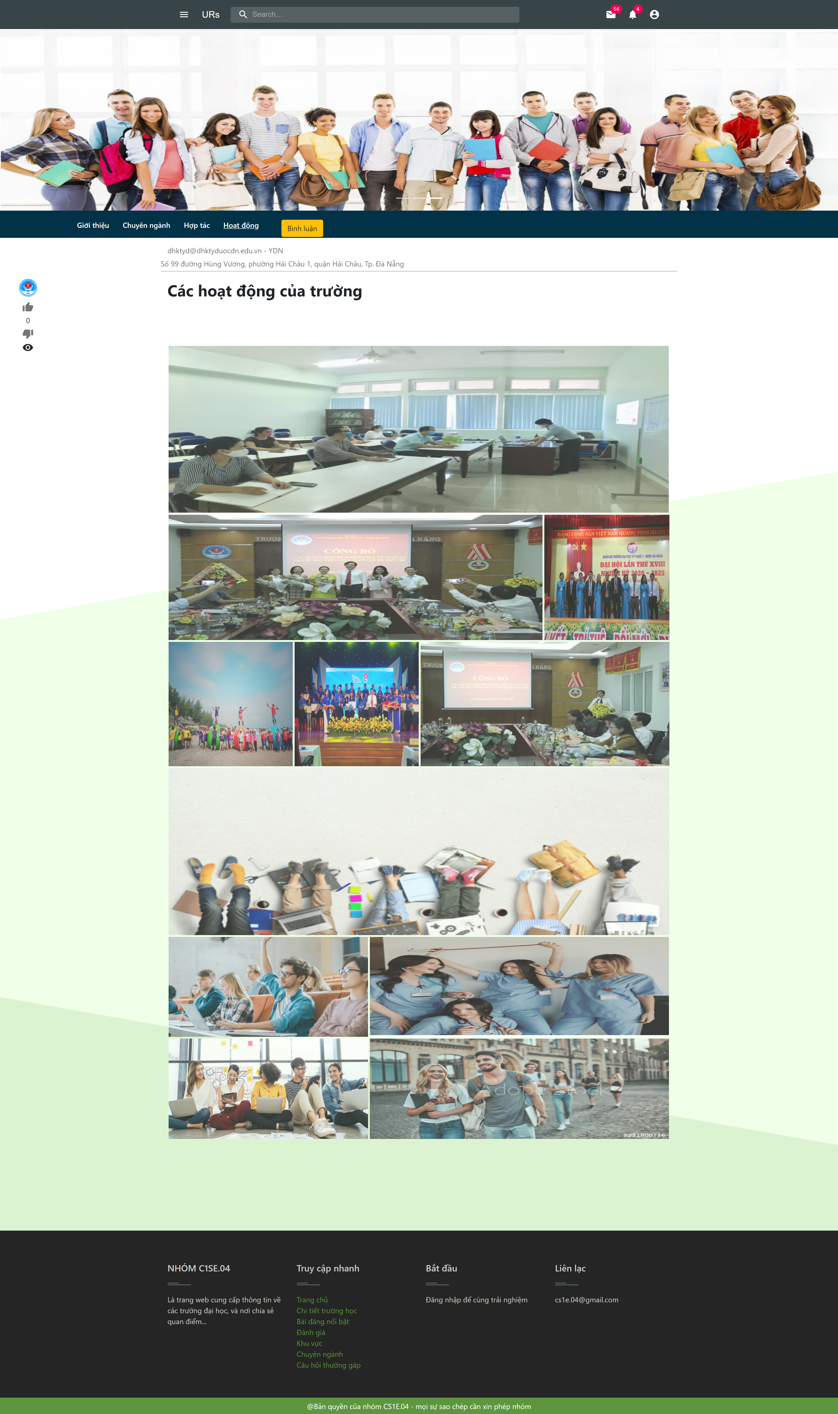
demo

Slide 31
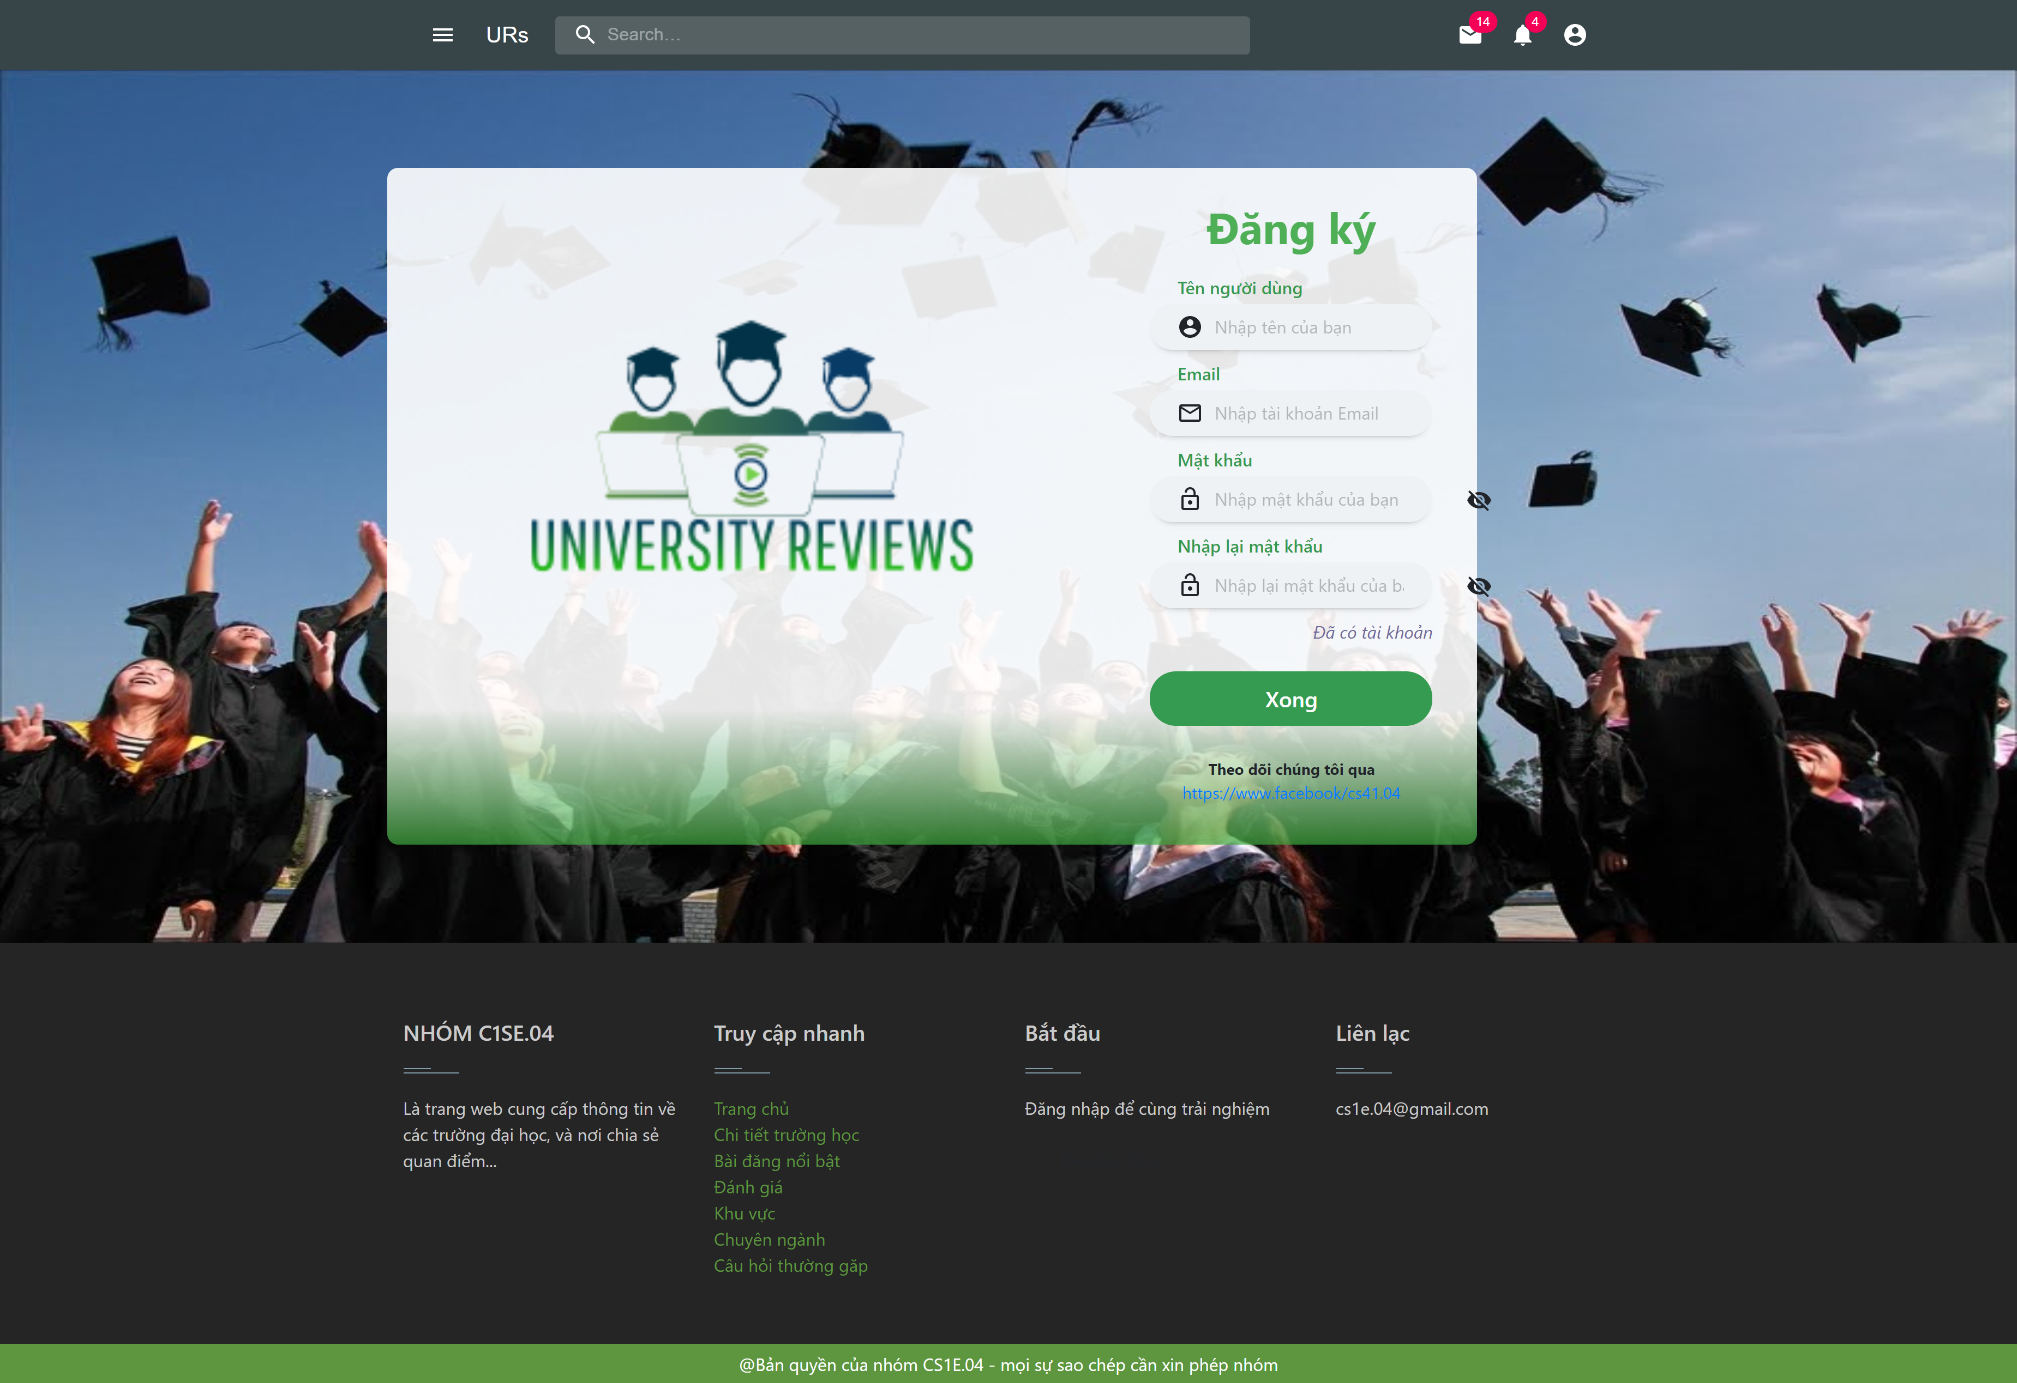
demo

Slide 32
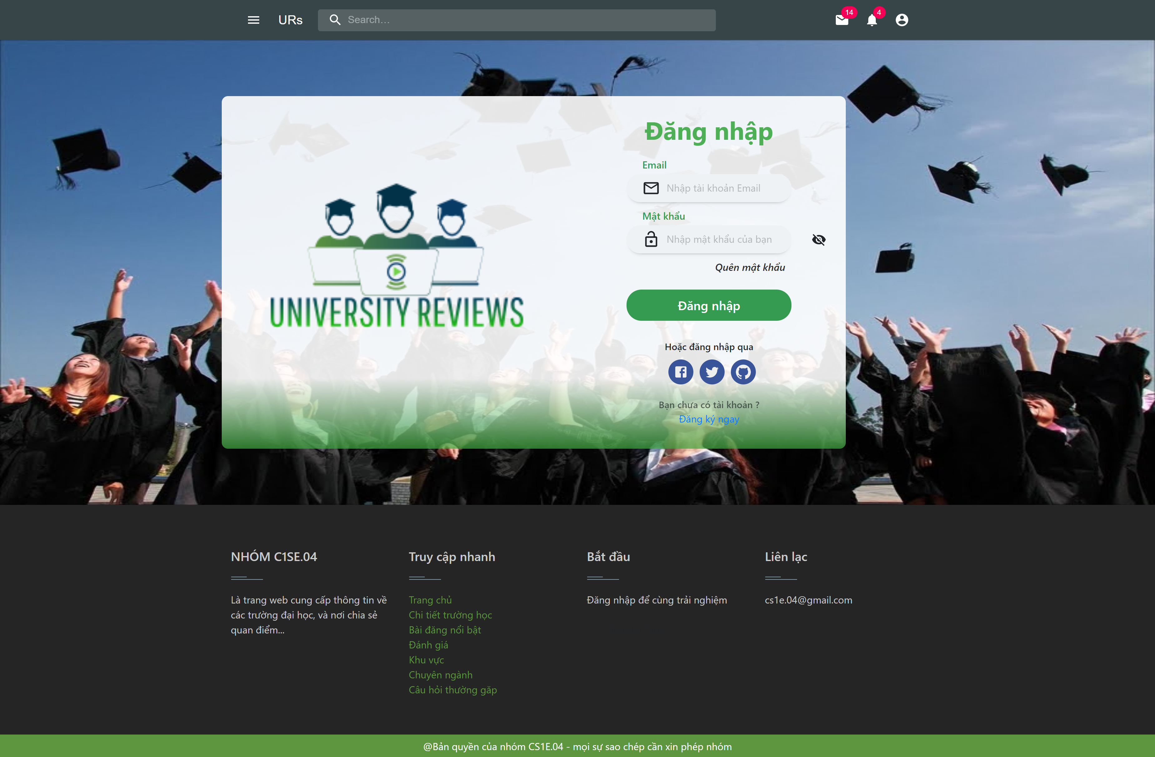
demo

Slide 33
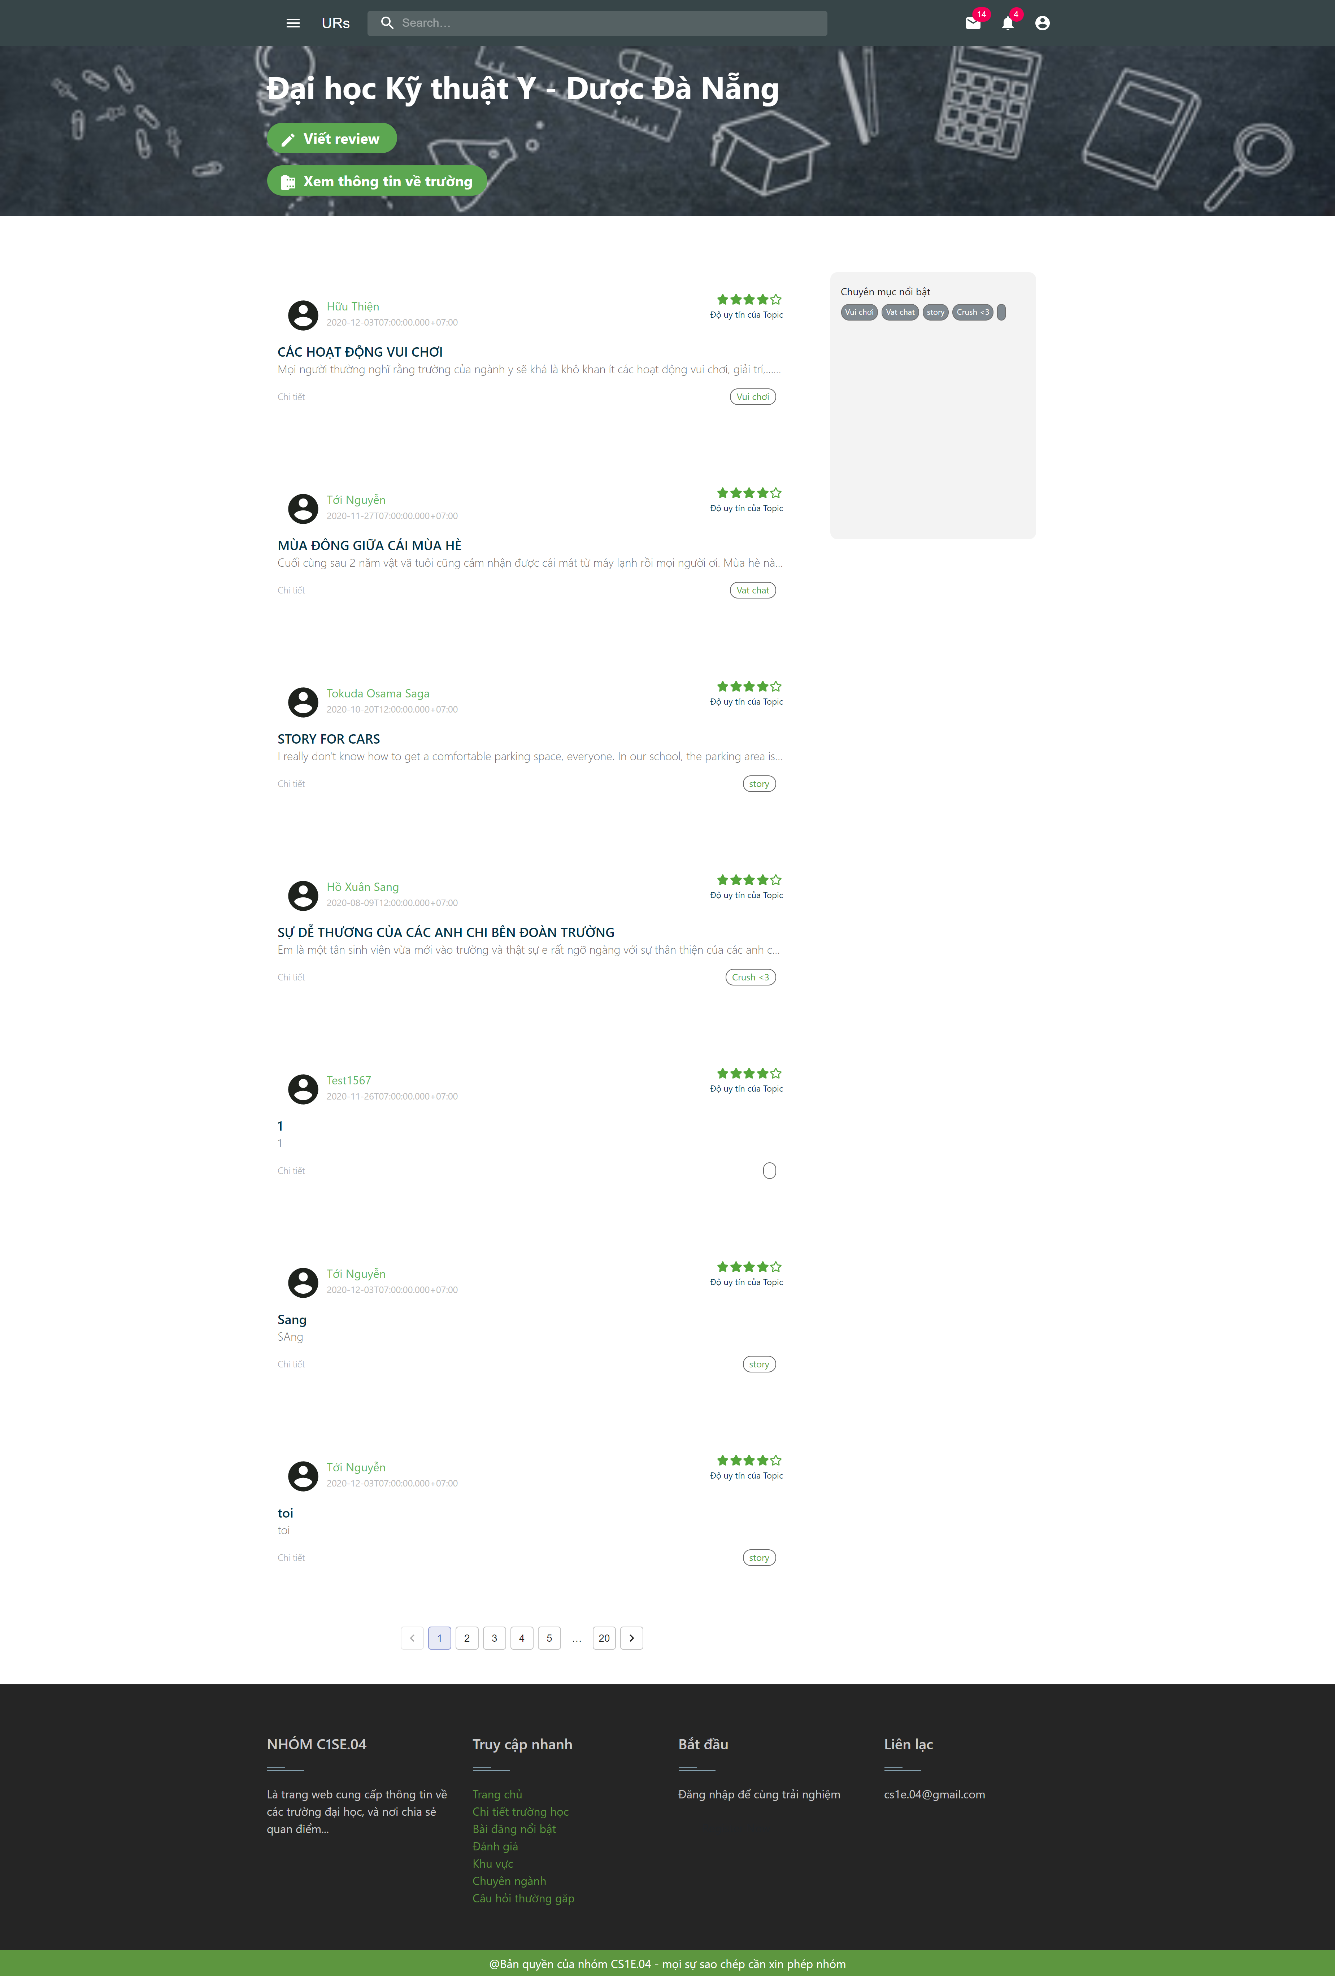
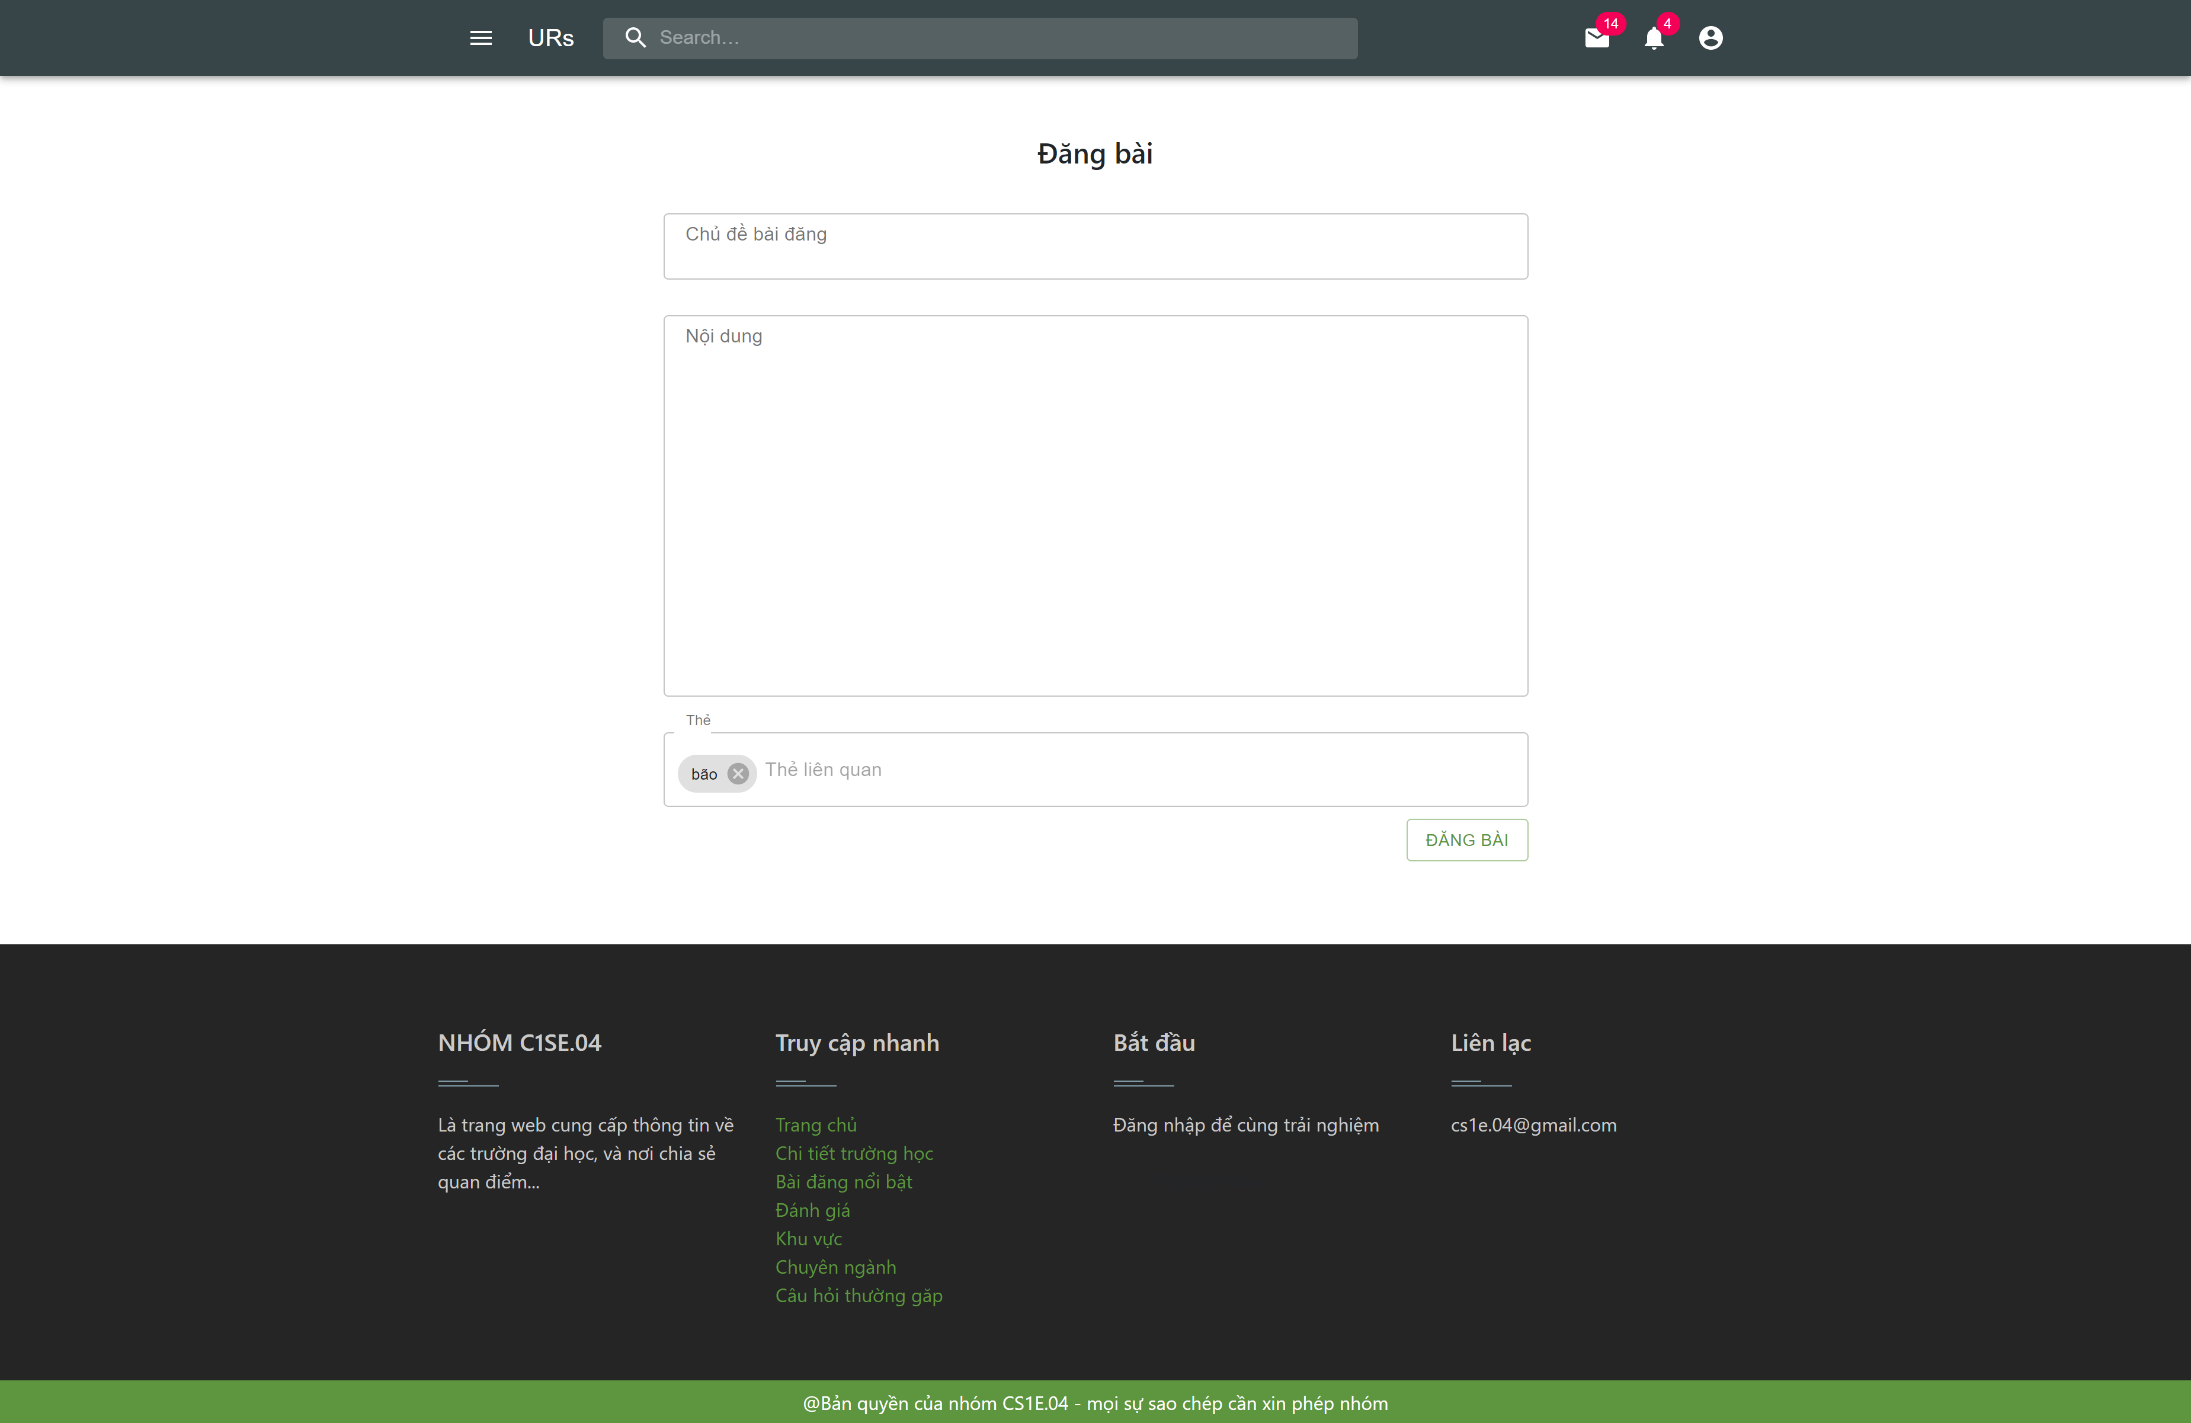
demo

Slide 34
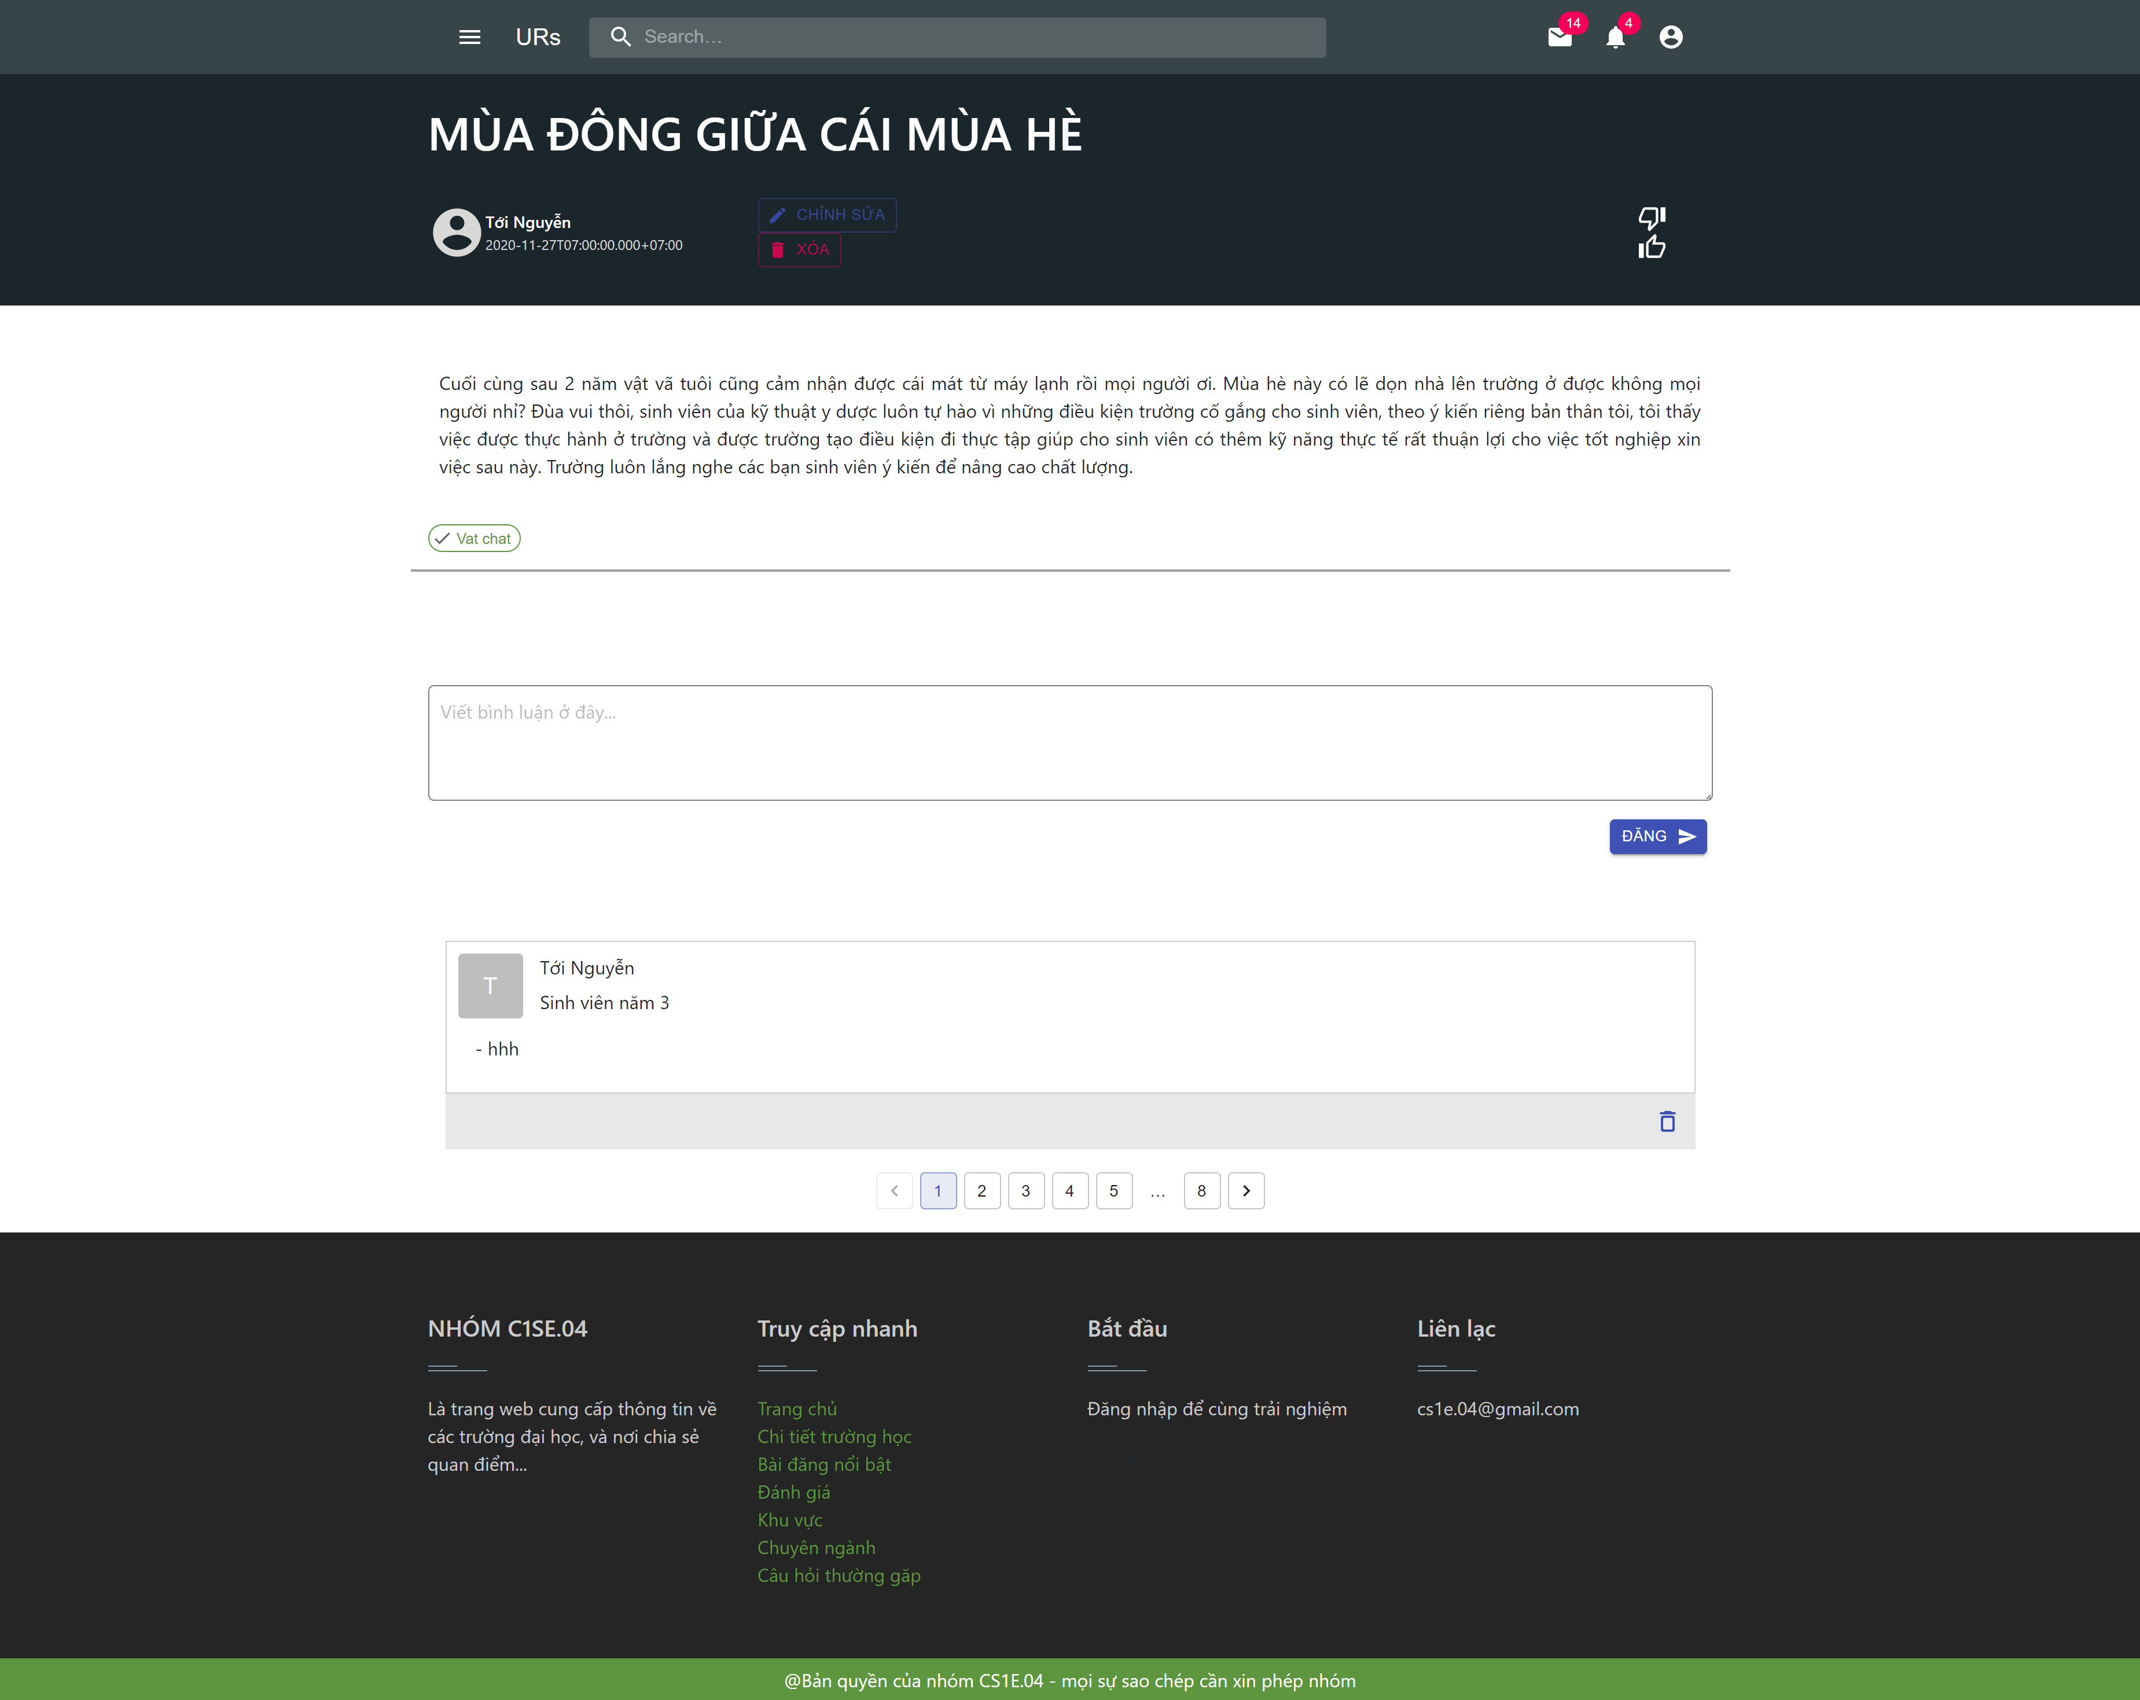
demo

Slide 35
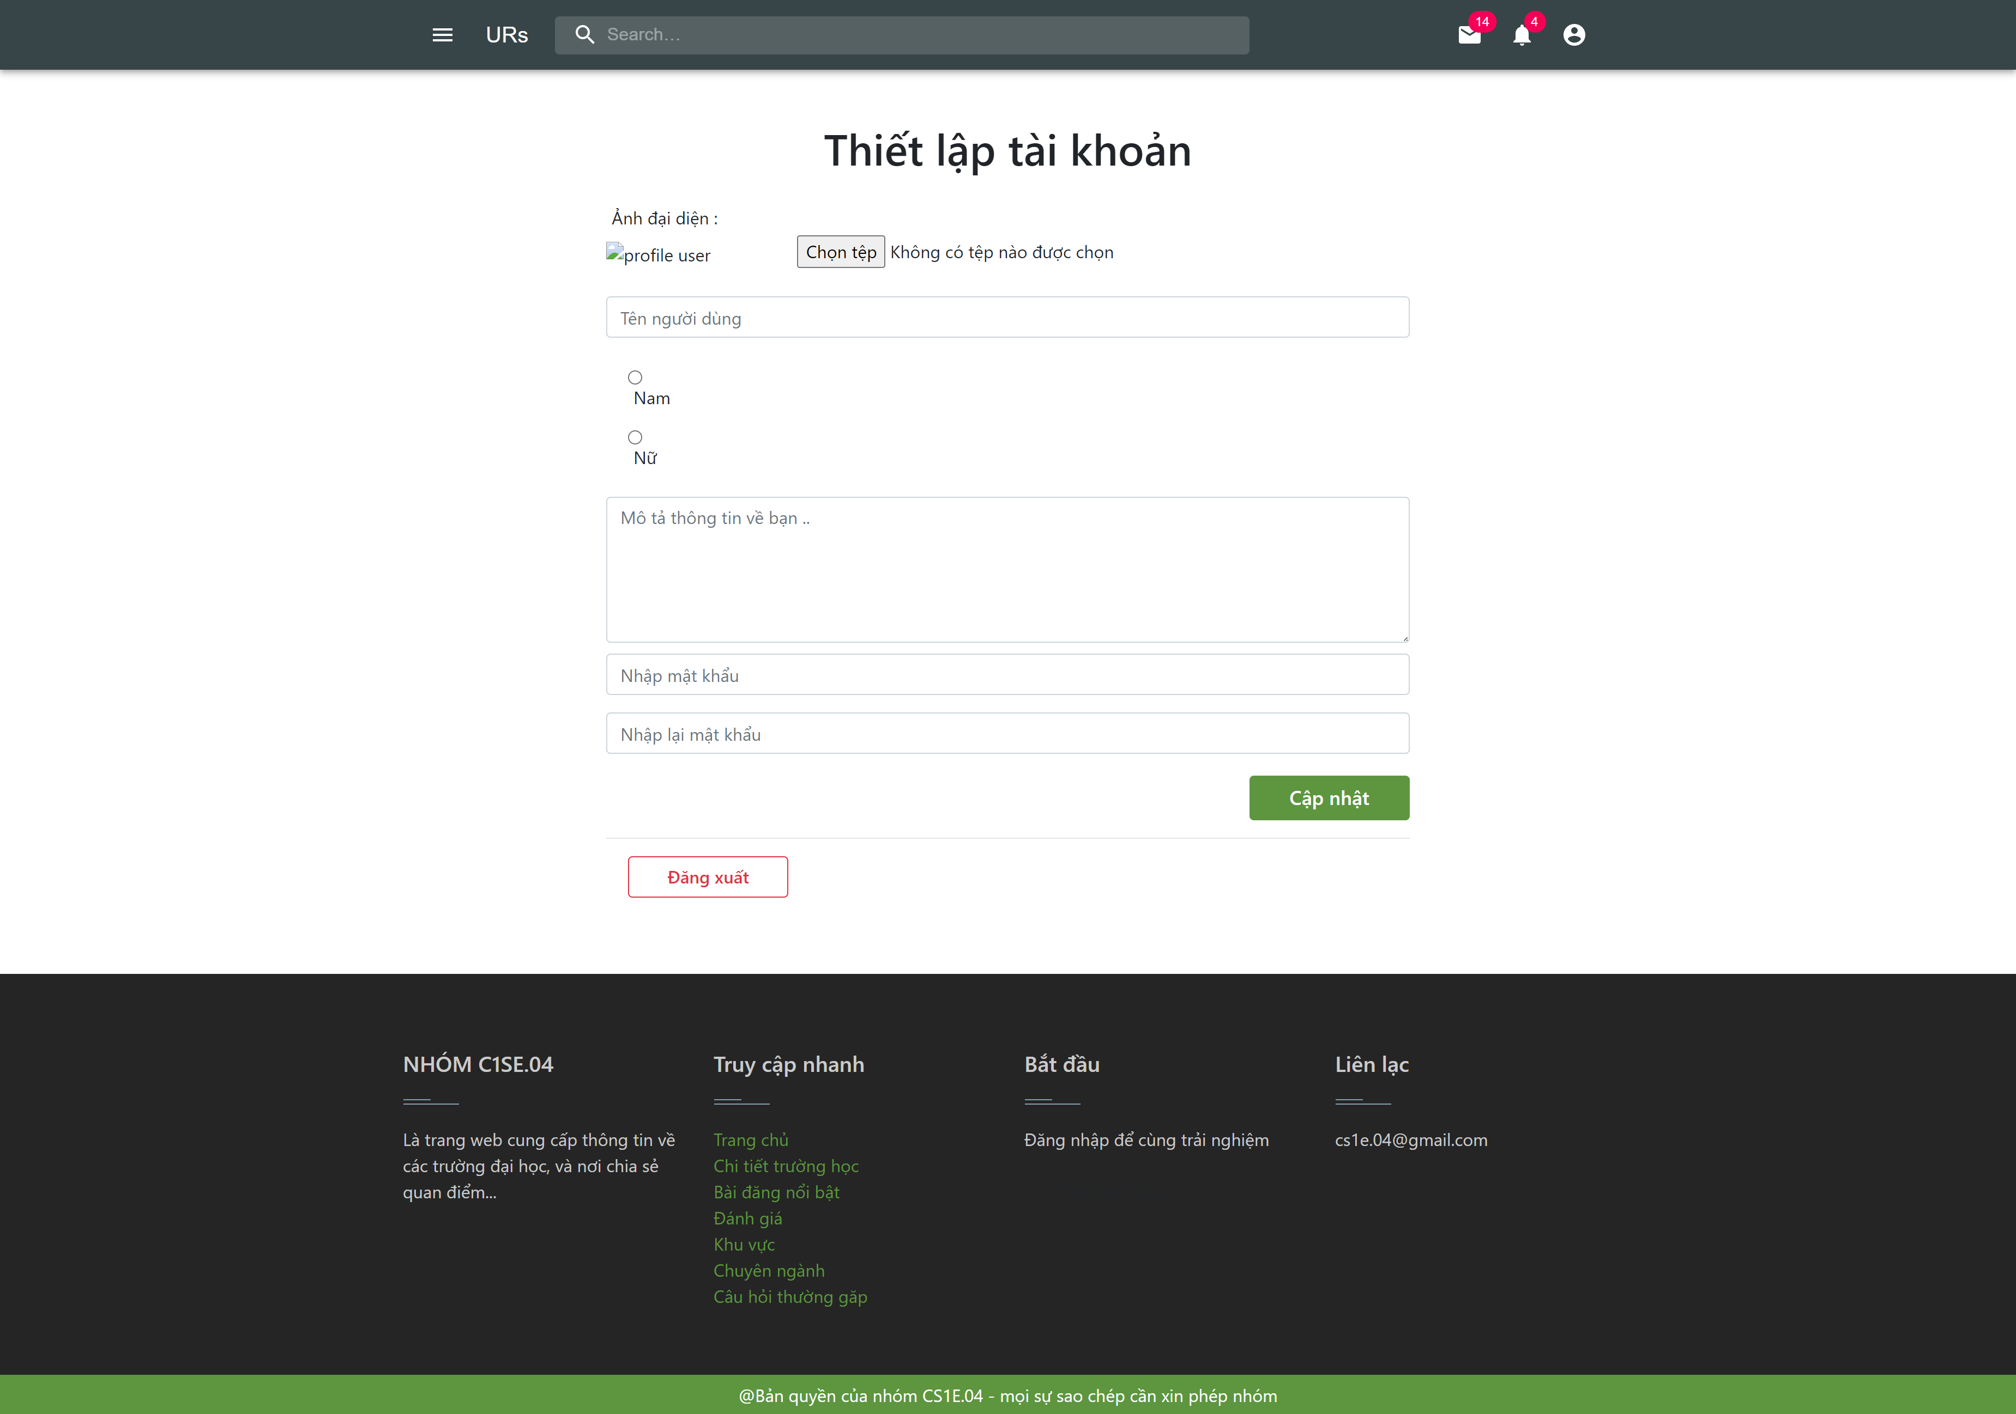
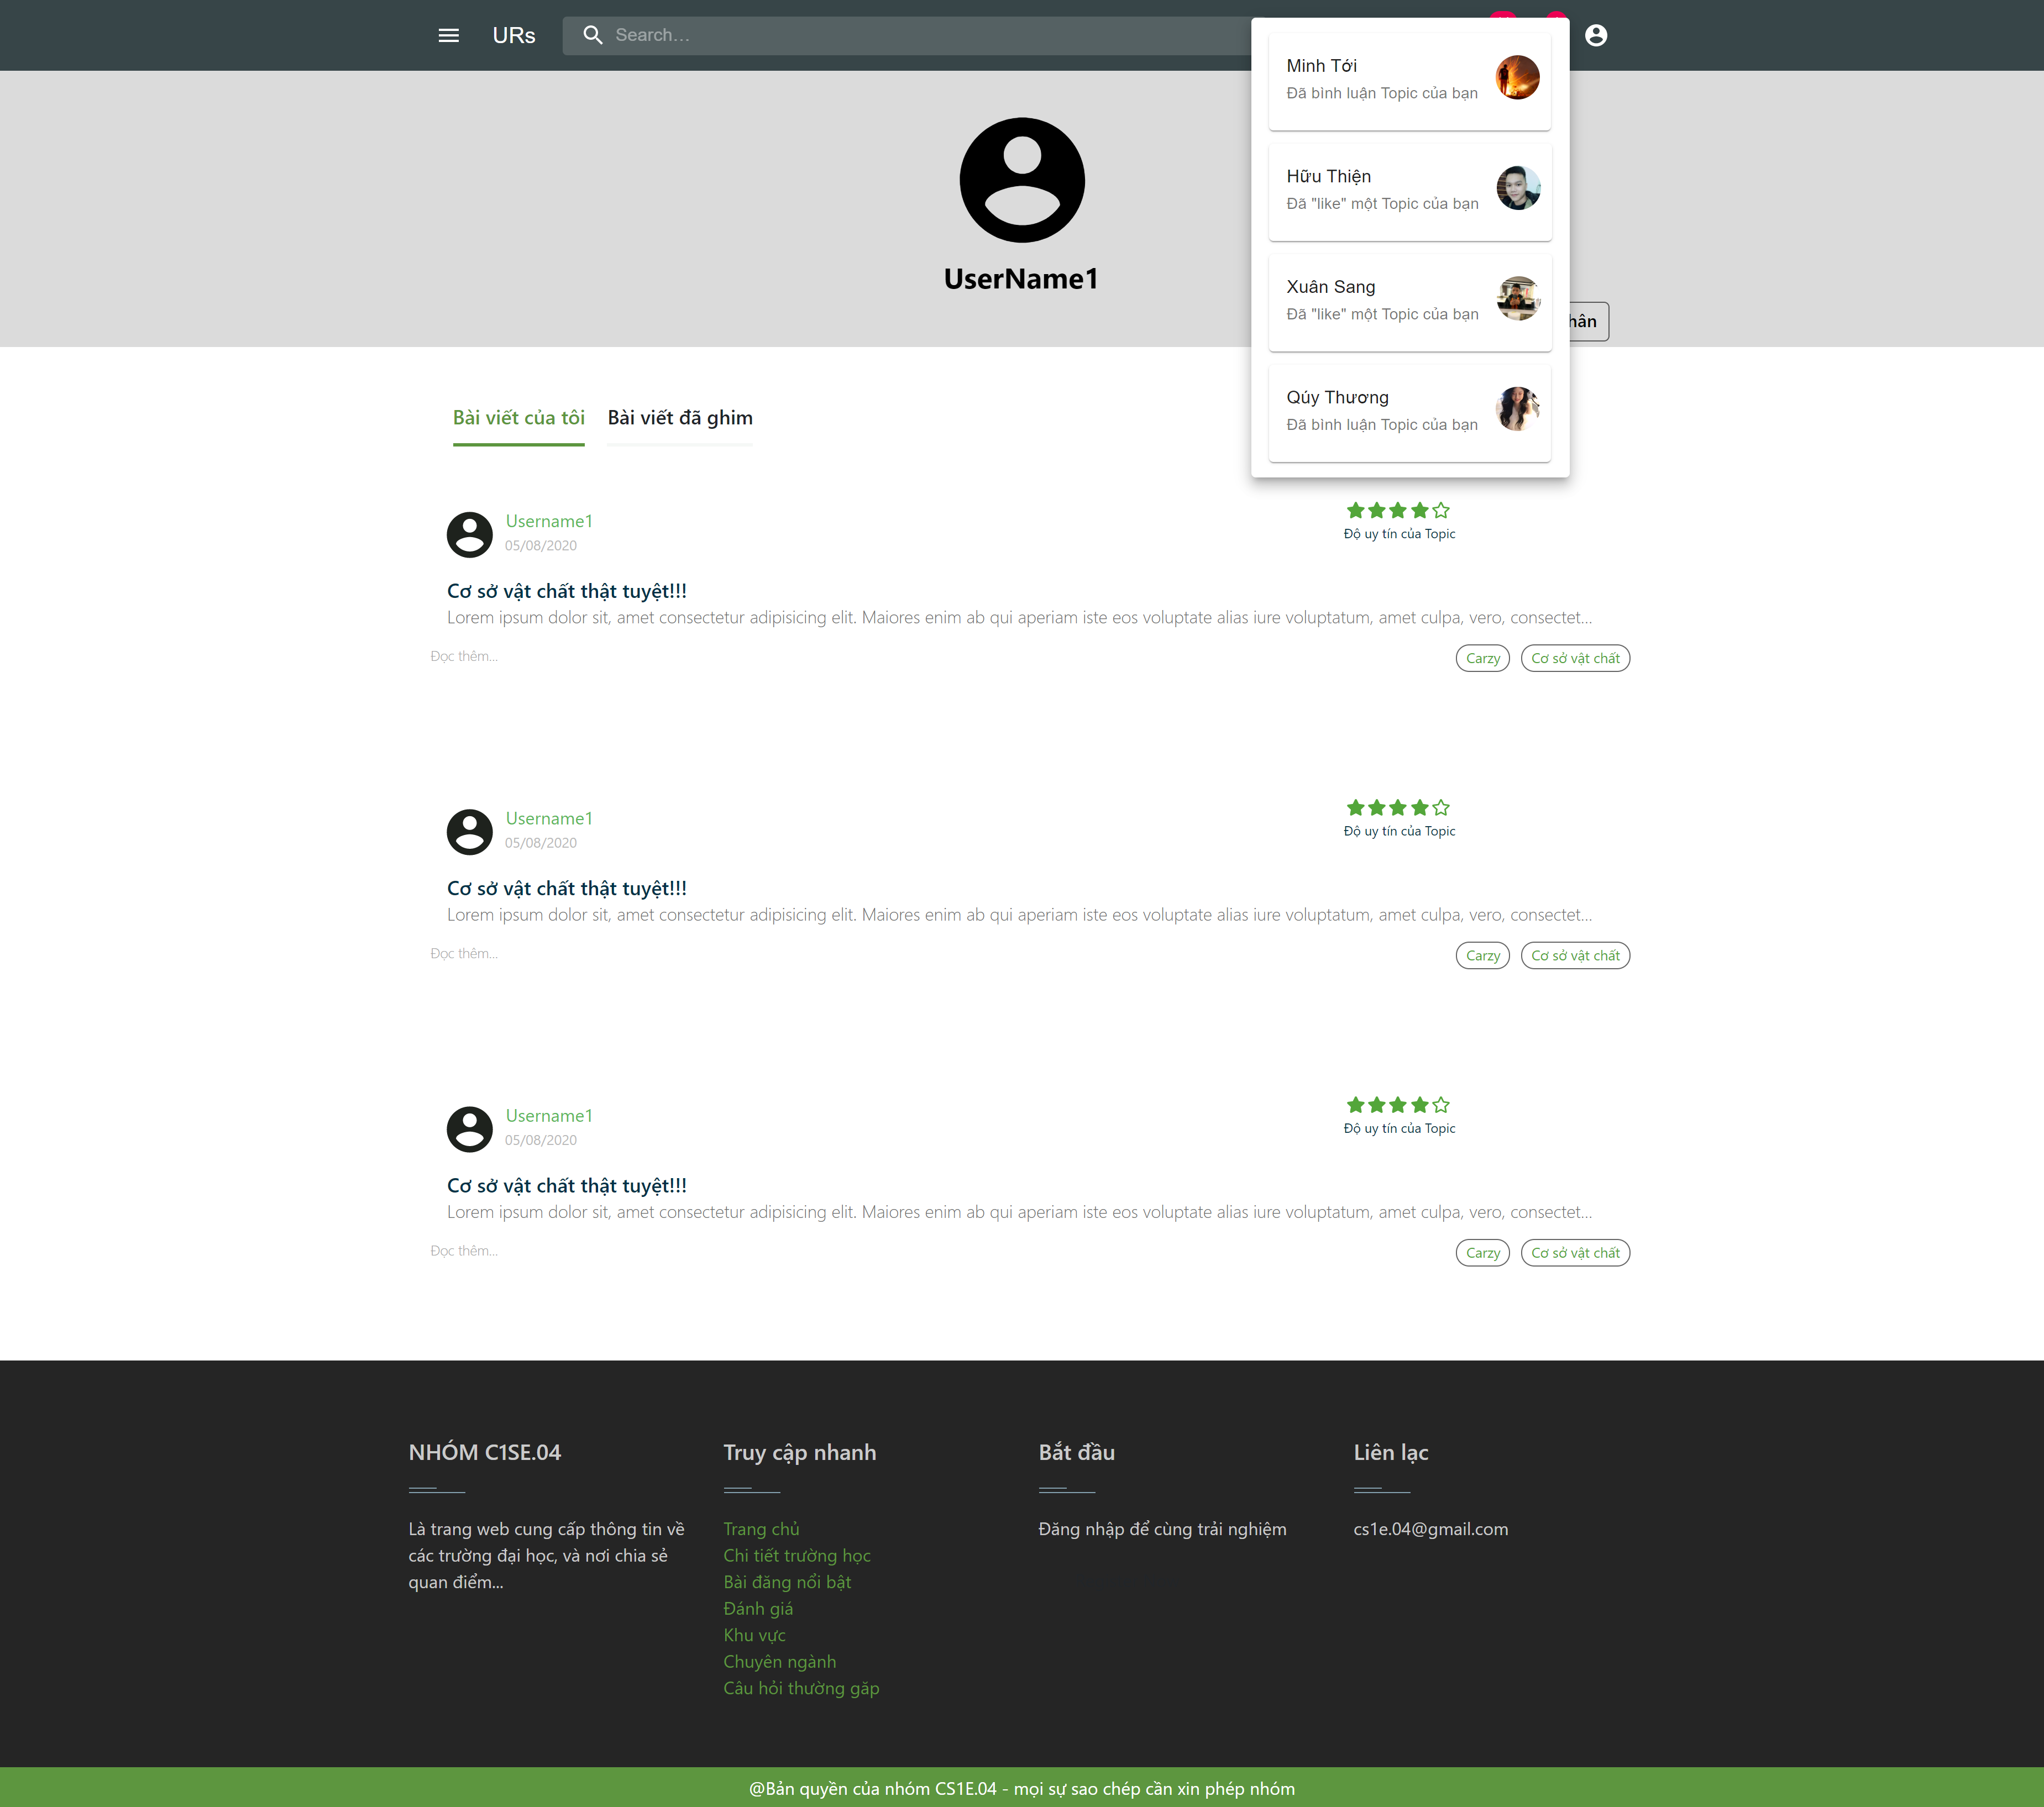
demo

Slide 36
Dự phòng

Slide 37
Dự phòng

Slide 38
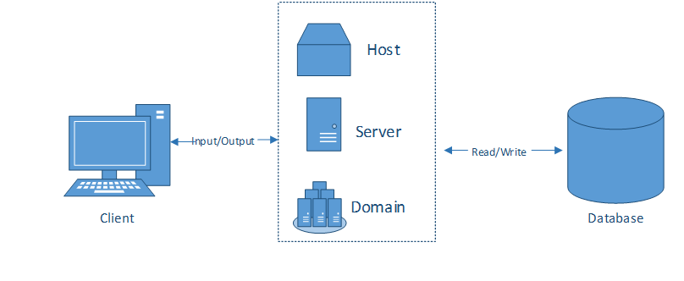
Allocation view
WORK PROGRESS

Slide 39

Process
Sprint 1
Sprint 2
Sprint 3
Sprint 4
Finished
Finished
Processing
Unfinished

Slide 40

Problems encountered
Unfinished achitecture documentation
Have not written test documents

Slide 41

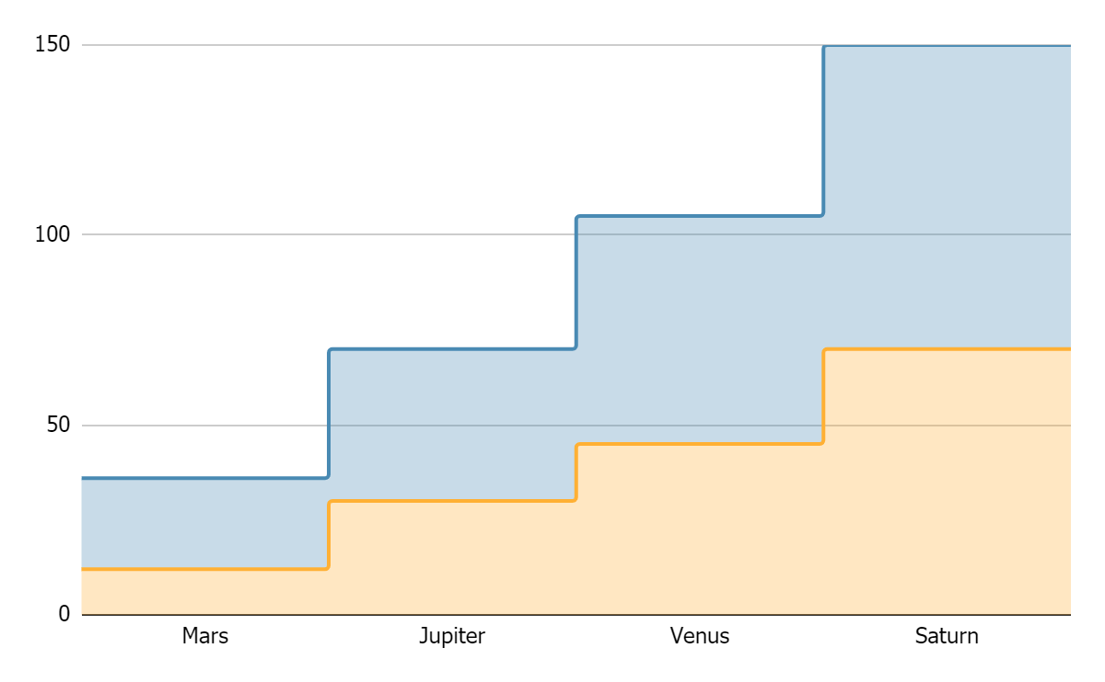
TOPIC DATA
Mercury
Pluto
If you want to modify this graph, click on it, follow the link, change the data and replace it

Slide 42




RECOMMENDATIONS
MARS
VENUS
JUPITER
SATURN
Despite being red, Mars is actually a cold place
Venus has a beautiful
name, but it’s hot
It’s the biggest planet in our Solar System
Saturn is the ringed one
and a gas giant

Slide 43




PRACTICAL EXERCISE
Mercury is the closest planet to the Sun and the smallest one in the Solar System—it’s only a bit larger than our Moon. The planet’s name has nothing to do with the liquid metal, since it was named after the Roman messenger god, Mercury

Slide 44
ALTERNATIVE RESOURCES

Slide 45
RESOURCES
Did you like the resources on this template? Get them for free at our other websites.
VECTORS
People working at the office flat design
Collection of young men and women reading
Set of young men and women reading
Flat business landing page template
People at the office
People at the office
Flat world book day banners
Office workers sitting at desks
PHOTOS
Close-up of woman doing her work
If you want to apply the same filter as the picture included in the template, follow these instructions:
IN GOOGLE SLIDES:
Insert the picture in the slide.
Go to Format options and recolor the picture by applying a black & white filter.
Create a shape with the same size as the picture and fill it with the #ffad802f color.
Place the shape on top of the picture. You can adjust the transparency as you see fit.

Slide 46
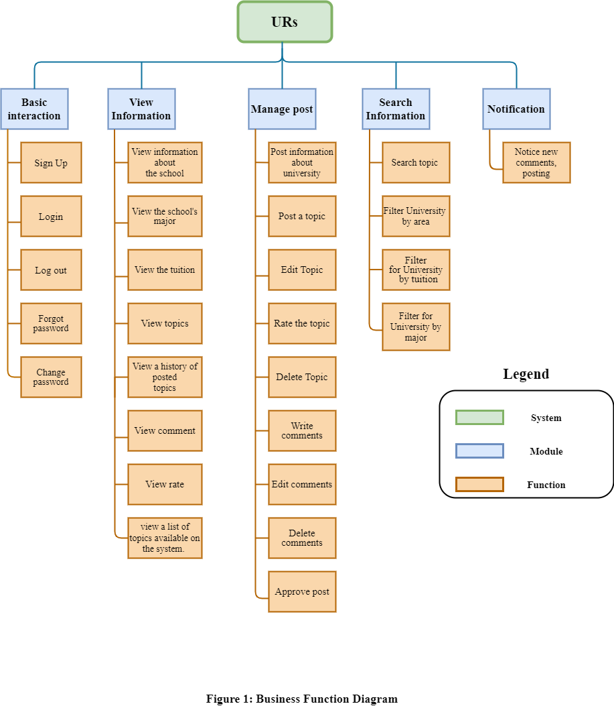
CAPSTONE1
Module Management System

Slide 47
CONTENTS
CAPSTONE1
Business Issuse
Solution
Who ?
Design Web
Project Architecture
Relationship Diagram
Develop tool
Project Process
Risk & Evaluation
Demo

Slide 48
CAPSTONE1
BUSSINESS ISSUES
-Every year, more than 640,000 candidates register to enter the university. Currently, Vietnam has about 224 universities.
-With a huge number of candidates, and so many universities, it is difficult for a candidate to choose a major into the desired school.
-The information is not integrated, information about the school is not detailed, candidates can not imagine much information about the school.
-They only talk generally about the school, little mention about issues such as facilities, the feeling of students studying at that school...
-Many universities and college students still cannot succeed because they choose a major that is not in the right forte, with the right interest.
-The students at the school mainly study at school to get the basic knowledge, but many of them still do not have the ability to self-improve, have no direction in the majors, or do not understand the subject they choose.

Slide 49
CAPSTONE1
SOLUTION
o Provide all subject information.
o Compile a list of all schools with that discipline and organized by region (North, Central, South or province / city) or tuition rate, rating. And each will provide the following information:
• Benchmark entry, tuition in the last 3 years.
• About the school.
• There are topics about the school, a place to exchange and answer questions between students who have been studying at the school and candidates.

